Slide 1
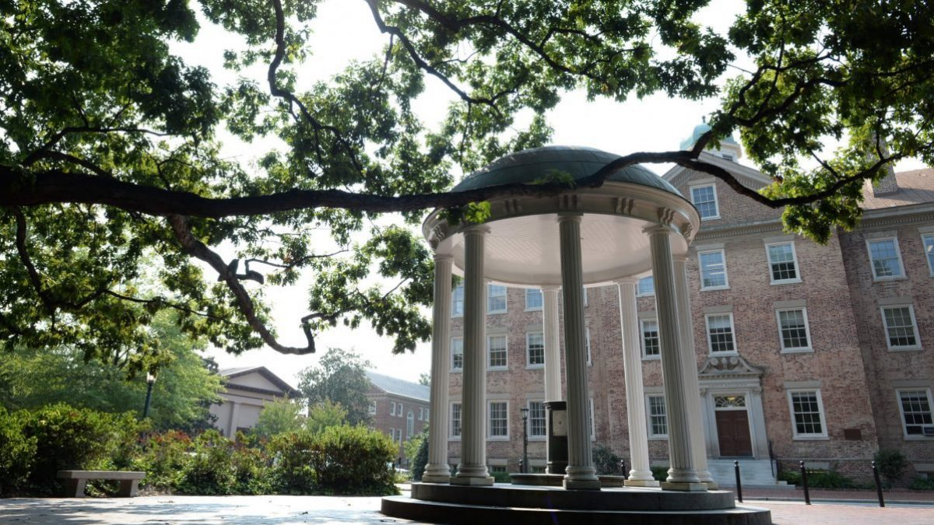
Strategic Visioning Faculty Town Hall
Phase 1
September 24th, 2020

Slide 2
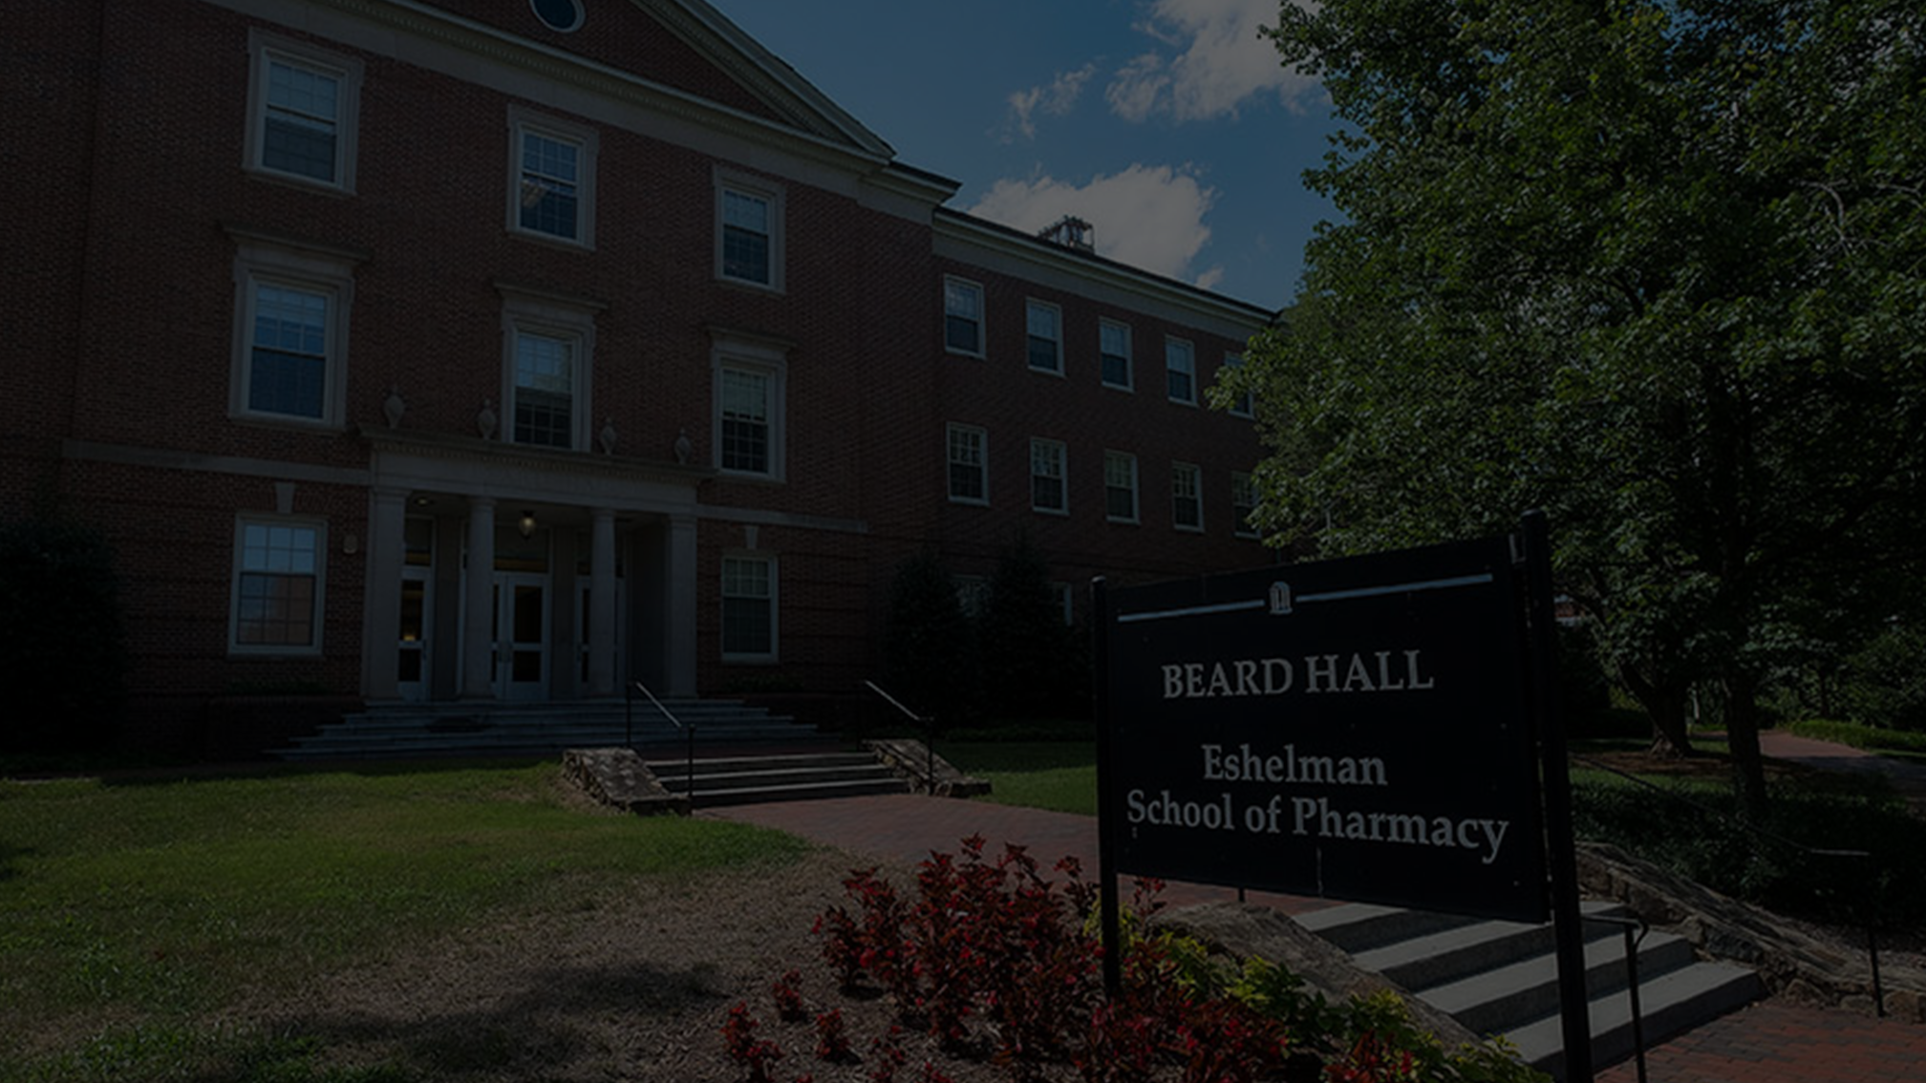
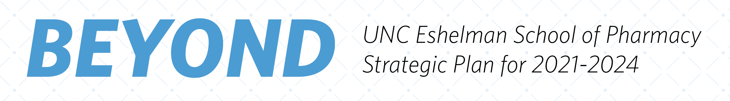

Slide 3
1
Project Overview
2
Strategic Planning Overview
Agenda
3
Phase 1 SWOT
4
Next Steps

Slide 4
UNC School of Pharmacy Task Force
Angela Kashuba
Dean
Scott Savage
Executive Vice Dean-Chief Operating Officer
Mary McClurg
Executive Vice Dean-Chief Academic Officer
Wendy Cox
Vice Dean of Professional
Education
Kim Brouwer
Associate Dean for Research
and Graduate Education
Benyam Muluneh
Assistant Professor, Division of Pharmacotherapy & Experimental Therapeutics
Mollie Scott
Regional Associate Dean at Asheville
John Bamforth
Director, Eshelman Institute
for Innovation
Carla White
Associate Dean, Organizational
Diversity and Inclusion
Roy Zwahlen
Associate Dean for Strategic
Risk Management
Stan Parker
Senior Director of Marketing
and Communications
Tab Waldrop
Alumnus
Kelly Collins
Assistant Director of Development and Campaign Director

Slide 5
Consulting Team
Lead Consultant
Project Leader
Paul Friga
Aditi Borde
Dale Ziobro
Director of Student Teams Achieving Results and Global Business Projects
Previously worked for PwC and McKinsey & Company
Received his PhD and MBA from UNC Kenan-Flagler
MHA/MBA ’20 (Concentration: Healthcare)
UNC BS Chemistry, minor: Biology
3+ years of experience in provider-side healthcare operations and research
Going to Deloitte Consulting full time (Jan 2021 start date)
MBA ’21 (Concentration: Healthcare and Entrepreneurship)
Intern at Deloitte and 501 Ventures for summer 2020
4+ years of experience in provider-side operations, strategy, and data analytics
Sam Reidy
Nisarg Shah
PharmD/MBA ’22 (Concentration: Healthcare and Marketing)
UNC BS Biology, minor: Chemistry
2+ years of experience in pharmacy operations and Pharma strategy
Intern at Eli Lilly and Co. for summer 2020
BA ‘22 Economics and Public Policy
Business Minor
Morehead-Cain Scholar
Intern at ABC Insights for summer 2020
Key responsibilities include secondary research, primary research, analysis of options, slide deck creation, and updates to key constituents

Slide 6
Our Goals and Methodology
Strategic Planning Overall
1. Internal: Guide decision making of the school to be consistent with the strategic direction of the organization
2. External: Inform key constituents of our plan to ensure buy in and support
UNC School of Pharmacy Strategic Planning Process
1. Strategic plan for the next 3 years (mission, values, vision, priorities, objectives, initiatives, and budgets)
2. Strategic thinking training to UNC Eshelman School of Pharmacy leaders
3. Strategic input from key constituents
Task Force Meetings
1. Understand approach
2. Review assessment data
3. Generate insights and ideas (captured by consulting team) – ongoing at the end of each section
Advisory Meetings
1. Feedback on ideas
Faculty, Staff, Student Town Halls
1. Feedback on ideas before advisory meetings
2. Understanding of the strategic planning process
3. Buy-in and support from faculty, staff, and students through 3 town hall meetings
2. Agreement as to next steps
3. Buy in and support

Slide 7
Advisory Committee
Name | Title | Organization | Affiliation
Jeff Aube | Distinguished Professor, CBMC | UNC Eshelman School of Pharmacy | Faculty
Laura Bonifacio | President of Lodestar Pharma Consulting, LLC | Lodestar Pharma Consulting, LLC | Alumni
Tina Brock | Director, Pharmacy Education | Monash University (Parkville campus) | Partners
DeAnne Brooks | Chief Pharmacy Officer | Cone Health | Partners
Rashonda Burkett | Medical Science Liaison Excellence Lead | Novart | Alumni
Julie Byerley | Vice Dean for Academic Affairs and Chief Education Officer | UNC School of Medicine | Partners
Udobi Campbell | Regional Director of Pharmacy; ESOP Executive Associate Dean for Clinical Practice | UNC HealthCare | Faculty
Arthur Christopoulos | Dean and Professor | Monash University School of Pharmacy | Partners
Duncan Craig | Director and Professor | University College London School of Pharmacy | Partners
Stephen Eckel | Associate Dean for Global Engagement; Associate Professor, PACE | UNC Eshelman School of Pharmacy | Faculty
Jackie Feaster | Director of Foundation Accounting | UNC Eshelman School of Pharmacy | Staff
Stefanie Ferreri | Chair & Distinguished Professor, PACE | UNC Eshelman School of Pharmacy | Faculty
Neil Fowler | CEO | Liquidia Technologies | Alumni
Emily Gangi | Policy Engagement Director | NC IMPACT at UNC Chapel Hill | Partners
Ouita Gatton | Adjunct Assistant Professor, PACE; Preceptor | UNC Eshelman School of Pharmacy | Faculty
Danny Gonzalez | Associate Professor, DPET | UNC Eshelman School of Pharmacy | Co-chair
Chris Gosk | Director of Organizational Effectiveness, Planning, and Assessment | UNC Eshelman School of Pharmacy | Staff
Annie Hager-Blunk | Associate Dean for Advancement | UNC Eshelman School of Pharmacy | Faculty
Jeff Heck | CEO | Mountain Area Health Education Center | Partners
Mike Jarstfer | Assistant Dean for Graduate Education | UNC Eshelman School of Pharmacy | Faculty
Key responsibilities include offering ideas and input related to strategy to task force, responding to draft strategy statements and support in scheduled meetings, and communicating progress to key constituents

Slide 8
Advisory Committee
Name | Title | Organization | Affiliation
Mike Jay | Chair & Distinguished Professor, DPMP | UNC Eshelman School of Pharmacy | Faculty
Brittany Jennings | Director, Brand Alignment/Communications | UNC Eshelman School of Pharmacy | Staff
Lynn Kieffer | Member, Board of Directors | Mission Health System | Alumni
Jasmine King | Graduate Student, DPMP | UNC Eshelman School of Pharmacy | Students
Nathan Knuffman | Senior Associate Vice Chancellor for Finance and Operations | University of North Carolina at Chapel Hill | Partners
Abby Kruse | Assistant Director for Experiential Programs | UNC Eshelman School of Pharmacy | Staff
David Lawrence | Chair & Distinguished Professor, CBMC | UNC Eshelman School of Pharmacy | Faculty
Craig Lee | Associate Professor, DPET | UNC Eshelman School of Pharmacy | Faculty
Judith Lovince | HSPA Master Student, PACE | UNC Eshelman School of Pharmacy | Students
Jacqui McLaughlin | Associate Professor, PACE; Director, CIPhER | UNC Eshelman School of Pharmacy | Co-chair
Ralph Meekins | UNC Board of Trustees | University of North Carolina at Chapel Hill | Partners
Mike Melroy | System Director of Pharmacy | New Hanover Regional Medical Center | Partners
Mike Mulkeen | Executive Assistant, ESOP Asheville | UNC Eshelman School of Pharmacy | Staff
Louis Newsome | Pharmacy Program Executive | UnitedHealthcare | Alumni
Chris Parish | PharmD Student; Student Senate President | UNC Eshelman School of Pharmacy | Students
Herb Patterson | Interim Chair and Professor, DPET | UNC Eshelman School of Pharmacy | Faculty
Chris Peronto | Vice President, Head of Enterprise Strategy & Innovation | BlueCross NC | Partners
Jasmine Perry | PharmD Student; SNPhA President | UNC Eshelman School of Pharmacy | Students
Sara Pettaway | Executive Assistant to the Dean | UNC Eshelman School of Pharmacy | Staff
Wayne Pittman | Associate Dean for Facilities Planning and Resource Analysis; Associate Professor, DPET | UNC Eshelman School of Pharmacy | Faculty
Key responsibilities include offering ideas and input related to strategy to task force, responding to draft strategy statements and support in scheduled meetings, and communicating progress to key constituents

Slide 9
Advisory Committee
Name | Title | Organization | Affiliation
Kamakshi Rao | Assistant Director of Pharmacy; ESOP Adjunct Faculty | UNC Health Care | Faculty
Denise Rhoney | Associate Dean for Education and Learning Innovation; Distinguished Professor, PACE | UNC Eshelman School of Pharmacy | Faculty
David Routh | UNC Vice Chancellor for Development | University of North Carolina at Chapel Hill | Partners
Wayne Sasser | Representative of District 67 | North Carolina House of Representatives | Partners
Katie Sheldon | District Director of HCA | Mission Health System | Partners
William Slattery | Partner; ESOP Pinnacle Hill Steering Committee Member | Deerfield Management | Partners
Betsy Sleath | Chair & Distinguished Professor, DPOP | UNC Eshelman School of Pharmacy | Faculty
Alex Tropsha | Associate Dean for Data and Data Science; Distinguished Professor, CBMC | UNC Eshelman School of Pharmacy | Faculty
Greg Vassie | Co-founder, & CFO | IndyCare | Alumni
Abbie Williamson | Executive Director of Pharmacy | WakeMed Health and Hospital | Partners
Brad Wingo | Assistant Dean of Students | UNC Eshelman School of Pharmacy | Staff
Key responsibilities include offering ideas and input related to strategy to task force, responding to draft strategy statements and support in scheduled meetings, and communicating progress to key constituents

Slide 10
The 3 Phases of the Strategy Project
Phase 1 – Assessment
Internal
& external surveys
Phase 2 –
Visioning
Draft Strategy Statements:
Phase 3 – Implementation
Implementation Plan:
Interviews
Summary SWOT
Vision
Mission / Values
Key Metrics
Background Fact Pack
Objectives
Benchmark
Priorities
Oct 28 – Dec 16
Initiatives
Supporting Metrics
July 31 – Sept 30
Sept 30 – Oct 28

Slide 11
Project Workstreams
Internal Analysis Understand strengths and weaknesses | External Analysis Identify threats and opportunities | Communications Establish two-way interactions with campus
Review internal documents (strategic plan 2.0) Inventory skills and capabilities Benchmarking (connect with ABC insights team) Conduct survey of faculty, staff, students, and alumni | Research competitor schools and review news articles Search for best practice examples inside and outside of higher ed Conduct interviews with subject matter experts (research and consulting firms) Seek research on innovative new job opportunities within pharmacy fields and beyond | Assemble high-level advisory committee Determine PR and announcement objectives and process
Summarized and prioritized strengths and weaknesses Benchmark quantitative and qualitative survey results Internal fact pack Expand alumni database | Summarize and prioritize threats and opportunities Profiled global pharmacy school best practices (including top graduate schools) External fact pack | Town hall and advisory meetings Regular communications PR and announcement implementation plan
Sam Reidy Nisarg Shah | Dale Ziobro Gabby Kmiec | Aditi Borde
Analysis
Deliverable
Lead(s)

Slide 12
Master Schedule
Assessment
Visioning
Implementation
Phase I
Phase II
Phase III
Week | Date | Time | Meeting
1 | 07/31 | 9:30-11 | Task Force 1
2 | 08/07 | 9:30-11 | Task Force 2
3 | 08/14 | 9:30-11 | Task Force 3
4 | 08/21 | 9:30-11 | Task Force 4
5 | 08/28 | 9:30-11 | Task Force 5
6 | 09/04 | 8:30-10 | Task Force 6
7 | 09/11 | 8:30-10 | Task Force 7
8 | 09/18 | 8:30-10 | Task Force 8
8 | 09/18 | 12-1 | Student Town Hall 1
9 | 09/24 | 12-1 | Faculty Town Hall 1
9 | 09/24 | 1-1:50 | Staff Town Hall 1
9 | 09/25 | 8:30-10 | Task Force 9
10 | 09/30 | 5-6:30 | Advisory 1
Week | Date | Time | Meeting
10 | 10/02 | 8:30-10 | Task Force 10
11 | 10/09 | 8:30-10 | Task Force 11
12 | 10/16 | 8:30-10 | Task Force 12
13 | 10/21 | 12-1 | Faculty Town Hall 2
13 | 10/22 | 11-11:50 | Staff Town Hall 2
13 | 10/22 | 12-1 | Student Town Hall 2
13 | 10/23 | 8:30-10 | Task Force 13
14 | 10/28 | 5-6:30 | Advisory 2
14 | 10/30 | 3-4 | Alumni Town Hall
Week | Date | Time | Meeting
14 | 10/30 | 8:30-10 | Task Force 14
15 | 11/06 | 8:30-10 | Task Force 15
16 | 11/13 | 8:30-10 | Task Force 16
17 | 11/20 | 8:30-10 | Task Force 17
18 | 11/27 | n/a | Holiday: cancel
19 | 12/04 | 8:30-10 | Task Force 18
20 | 12/8 | 12-1 | Faculty Town Hall 3
20 | 12/8 | 1-1:50 | Staff Town Hall 3
20 | 12/9 | 12-1 | Student Town Hall 3
20 | 12/11 | 8:30-10 | Task Force 19
21 | 12/16 | 5-6:30 | Advisory 3

Slide 13
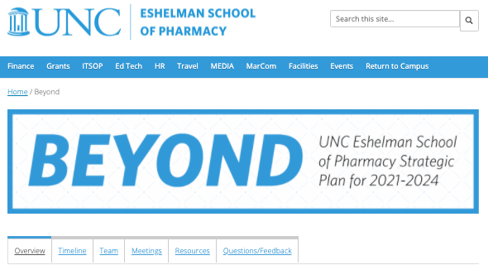
Visit ESOP Strategic Planning Website for Updates on the Strategic Planning Process
ESOP Strategic Planning Website
URL: https://faopharmacy.unc.edu/beyond
Notes:
https://faopharmacy.unc.edu/beyond/

Slide 14
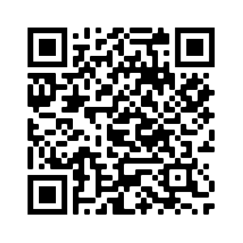
Provide Feedback Regarding SWOT Process via Survey Link
UNC Eshelman School of Pharmacy Phase I SWOT Feedback Form
https://tinyurl.com/EsopFeedbackPhase1
Providing feedback on the content presented over the entirety of this meeting will help drive the strategic planning process forward.
We will record your responses and analyze it to assess how well the strategic planning process is going.
It will remain open until October 4, 2020.
Notes:
PLEASE DO NOT CLOSE YOUR SURVEY UNTIL INSTRUCTED TO DO SO

Slide 15
1
Project Overview
2
Strategic Planning Overview
Agenda
3
Phase 1 SWOT
4
Next Steps

Slide 16
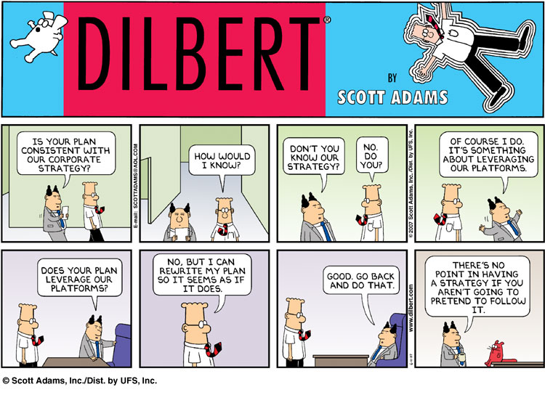
What is Strategy?
Strategy
Noun.
An elaborate
and systematic plan
of action.

Slide 17
The Content: Paul’s Four P’s of Strategy
Who are we?
What do we offer that is unique?
Where are we headed, exactly?
What is critical for success?
What activities must we do (BHAGs)?
What should we not do?
Position
Mission, Values & Vision
Priorities
Key Actions
Performance
Success Metrics
Payments
Budget
How do we measure success?
What controls should we implement?
How is our return vs. competitors’?
How much do we have to spend?
How should we allocate resources?
What budget process should we use?

Slide 18
Key Questions for Evaluating Strategy
Is it concise, clear and communicated?
Is it aligned with higher level strategies?
Does it address the 4 Ps?
  Positioning (mission, values, and vision)
  Priorities (no more than 3 for an overall unit)
  Payments (resource allocations)
  Performance (clear metrics)
Does it guide daily
decision making?

Slide 19
How Do Firms Create Strategies?
Crafting a Strategy
A 3 Step Process
External Analysis
Internal Analysis
Craft Strategy
(the Black Box)
Positioning
Priorities
Payments
Performance

Slide 20
There are Different Tools in the Strategy Process
Strategic Planning
Strategic Vision:
sustainable competitive advantage
X
Strategic Thinking
Strategic Tactics

Slide 21
SWOT analysis = great starting point (tip: no more than 3 per box!)
Strengths | Weaknesses
Opportunities | Threats
Traits within our organization that we could leverage in the future or mitigate through strategic actions
Internal Analysis
Elements outside of our organization over which we have no direct control but that could (and should) affect our strategy
External Analysis

Slide 22
SWOT Example – UNC School of Dentistry
Strengths
Sense of community
  Loyal alumni
  Dedicated faculty and staff
  Caring students
  Bond with UNC brand
Transformational lasting impact on health
  Research that impacts practice and policy
  Highly ranked in NIH funding
  Influential thought leaders
Broad-based education and care
  At every level within the dental health delivery system from chairside assistant to advanced specialty training
  Serving as a resource for complex patient care
Weaknesses
Curriculum
  Insufficiently integrated didactic and clinical education
  Overreliance on passive learning
Communication
  Lack of internal transparency, alignment, cooperation and trust
  External marketing of the UNC brand (tell our story)
  School-level collaboration across campus
Organization
  Inefficient processes and structure
  Inertia, complacency, misaligned incentives and resistance to change
  Lack of coherent vision and priorities
Opportunities
Embrace change to the pedagogical model of learning
  Modern curriculum
  New degrees
  Educational platforms
Engage and serve the North Carolina community through new ventures and programs
  Improve oral health of NC through partnerships
  Expand and grow services to external markets
Expand the global footprint
  Partnerships with international universities
  Establish an international DDS program designed to offset rising costs of student education
Threats
Decreasing funding
  Changing university financial model
  Dwindling research funding
  Decreasing state funds
Increasing competition
  Students and faculty from peer institutions
  Faculty and patients from private practice
Changing environment
  Decreasing segments of the patient population
  Evolving healthcare systems
  Rising costs of education

Slide 23
1
Project Overview
2
Strategic Planning Overview
Agenda
3
Phase 1 SWOT
4
Next Steps

Slide 24
We are looking for feedback on the Phase I SWOT deliverable
Phase 1 – Assessment
Internal
& external surveys
Phase 2 –
Visioning
Draft Strategy Statements:
Phase 3 – Implementation
Implementation Plan:
Interviews
Summary SWOT
Vision
Mission / Values
Key Metrics
Background Fact Pack
Objectives
Benchmark
Priorities
Oct 28 – Dec 16
Initiatives
Supporting Metrics
July 31 – Sept 30
Sept 30 – Oct 28
Notes:
Faculty, staff and students (n=1,133)
Preceptors (n=1,033)
Alumni and Friends (n=6,253)

Slide 25
Inputs into the Phase I SWOT
Organization Survey
Task Force Input
An organization-wide survey was conducted to get input from all stakeholders and constituents regarding the strategic planning process
Weekly meetings were held from a diverse set of stakeholders put together to represent as many perspectives as possible to iterate and discuss the SWOT outcomes
SWOT
Inputs
UNC Consulting Team Research
Stakeholder Feedback
The UNC Consulting Team conducts weekly research including competitive benchmarking and analysis of prior strategic planning initiatives and pharmacy trends
Feedback is encouraged including anonymous feedback on the UNC Eshelman School of Pharmacy Strategic Planning website, task force communication, and Town Hall and Advisory Committee meetings
The current Phase I SWOT will continue to be iterated upon as we continue to receive valuable feedback from Town Hall and Advisory Committee meetings

Slide 26
Inputs into the Phase I SWOT
Organization Survey
Task Force Input
An organization-wide survey was conducted to get input from all stakeholders and constituents regarding the strategic planning process
Weekly meetings were held from a diverse set of stakeholders put together to represent as many perspectives as possible to iterate and discuss the SWOT outcomes
SWOT
Inputs
UNC Consulting Team Research
Stakeholder Feedback
The UNC Consulting Team conducts weekly research including competitive benchmarking and analysis of prior strategic planning initiatives and pharmacy trends
Feedback is encouraged including anonymous feedback on the UNC Eshelman School of Pharmacy Strategic Planning website, task force communication, and Town Hall and Advisory Committee meetings
The current Phase I SWOT will continue to be iterated upon as we continue to receive valuable feedback from Town Hall and Advisory Committee meetings

Slide 27
Final Baseline Survey Statistics
Number of Responses
Fully Submitted Responses: 850
Partial Responses: 512
Response Rate by Affiliation
Faculty (n=135), 79%
Experiential Faculty (n=1,196), 13%
Staff (n=169), 66%
Students (n=837), 37%
Alumni (n=6,336), 10%
Strong response rate from all stakeholders of the survey demonstrate a successful survey with wide variety in thought
Source: UNC Eshelman School of Pharmacy Strategic Planning Survey
Notes:
Faculty, staff and students (n=1,133)
Preceptors (n=1,033)
Alumni and Friends (n=6,253)

Slide 28
Survey SWOT Analysis Metric
 | Rank | 1 | 2 | 3 | COMPOSITE SCORE
Attribute/Sentiment (Category) | Weight | 3 | 2 | 1
A weighted ranking system will be used to consider data collected through UNC Eshelman School of Pharmacy survey
A rank of most important (rank 1) awards an answer 3 points
A rank of second importance (rank 2) awards an answer 2 points
A rank of third importance (rank 3) awards an answer 1 point
By adding the collective points from survey responses, the analysis will be able distinguish which aspects of a question were the most pertinent to the UNC Eshelman School of Pharmacy Strategic Planning Process

Slide 29
UNC Eshelman School of Pharmacy Phase I SWOT
DRAFT
(Based on 850+ respondents from UNC Eshelman School of Pharmacy Strategic Planning Survey, 13 members of of the UNC Eshelman School of Pharmacy Strategic Planning Task Force, Competitive Benchmarking, Strategic Plan 2.0 2018-2020)
Strengths
Innovative and Rigorous PharmD Curriculum
  Early immersion experiences, strong clinical training/rotations
  Rigorous and challenging coursework
Exceptional and Dedicated Faculty
  In varying areas of research and expertise
  Committed to teaching and student success
Breadth and Depth of Research
  Innovative research enterprise with diverse research areas
Weaknesses
Organization and Fiscal Sustainability
  Too many initiatives and priorities, lack of accountability
  Too many leaders/administrators, lack of transparency
Diversity, Equity, and Inclusion
  Lack of diversity of faculty, staff, and students
Career and Curricular Options for Students
  Need for career opportunities outside of direct patient care
  Lack of adaptation to the changing healthcare market landscape
Opportunities
Preparing for Tomorrow’s Jobs
  New educational offerings: undergraduate, graduate & certificate
  Career services and support
Creation of New Markets for Pharmacy & Pharmaceutical Sciences
  Advancing the practice of pharmacy
  Entrepreneurship
Strategic Partnerships
  Collaboration with other UNC schools
  Partnerships across industry
Threats
Oversupply of Pharmacy Students
  Too many pharmacy schools, admitting too many students
  Declining number of traditional pharmacy jobs
Economy
  COVID-19, budget cuts, financial crisis, state/federal funding
  Fewer Applicants
    Declining number of applications, less qualified applicant pool (nationally)
    Decreased interest, declining enrollment

Slide 30
UNC Eshelman School of Pharmacy Phase I SWOT
DRAFT
(Based on 850+ respondents from UNC Eshelman School of Pharmacy Strategic Planning Survey, 13 members of of the UNC Eshelman School of Pharmacy Strategic Planning Task Force, Competitive Benchmarking, Strategic Plan 2.0 2018-2020)
Strengths
Innovative and Rigorous PharmD Curriculum
  Early immersion experiences, strong clinical training/rotations
  Rigorous and challenging coursework
Exceptional and Dedicated Faculty
  In varying areas of research and expertise
  Committed to teaching and student success
Breadth and Depth of Research
  Innovative research enterprise with diverse research areas
Weaknesses
Organization and Fiscal Sustainability
  Too many initiatives and priorities, lack of accountability
  Too many leaders/administrators, lack of transparency
Diversity, Equity, and Inclusion
  Lack of diversity of faculty, staff, and students
Career and Curricular Options for Students
  Need for career opportunities outside of direct patient care
  Lack of adaptation to the changing healthcare market landscape
Opportunities
Preparing for Tomorrow’s Jobs
  New educational offerings: undergraduate, graduate & certificate
  Career services and support
Creation of New Markets for Pharmacy & Pharmaceutical Sciences
  Advancing the practice of pharmacy
  Entrepreneurship
Strategic Partnerships
  Collaboration with other UNC schools
  Partnerships across industry
Threats
Oversupply of Pharmacy Students
  Too many pharmacy schools, admitting too many students
  Declining number of traditional pharmacy jobs
Economy
  COVID-19, budget cuts, financial crisis, state/federal funding
  Fewer Applicants
    Declining number of applications, less qualified applicant pool (nationally)
    Decreased interest, declining enrollment

Slide 31
Strength #1: Innovative and Rigorous PharmD Curriculum
UNC Eshelman School of Pharmacy’s innovative and rigorous PharmD curriculum is a top three strength reported by tenured/fixed-term faculty, experiential faculty, students, and alumni.
Students and Alumni ranked the PharmD curriculum as the #1 strength
Experiential Faculty, Tenured/Fixed-Term Faculty, and Staff ranked the PharmD curriculum as second, third, and fifth, respectively
“Learning how to learn. I was a member of the first class of the new curriculum and there were a lot of growing pains. But now being post-residency I see how constantly medicine is evolving and how important it is to be a lifelong/fast learner.” - Alumni
“Experiential opportunities - the amount of time I have spent on rotation has been so incredibly valuable” - Student
“Strong PharmD program with updated curriculum” - Faculty
“Innovations in curriculum (i.e. experiential learning starting early)” - Experiential Faculty
“Half of the curriculum is immersion based. This is so important and so valued by the students.” - Staff
Source: UNC Eshelman School of Pharmacy Strategic Planning Survey
(1) Additional Research

Slide 32
Strength #2: Exceptional and Dedicated Faculty
UNC Eshelman School of Pharmacy’s exceptional and dedicated faculty is a top three strength reported by tenured/fixed-term faculty, staff, students, and alumni.
On faculty dedication to the school and students…
55% of responses ranked the exceptional and dedicated faculty as the #1 strength
33% of responses ranked the exceptional and dedicated faculty as the #2 strength
72% of responses who identified faculty as a strength were non-faculty
“Faculty - the school has excellent faculty who clearly care about the success of the students”
- Student
“The instructors are world-class, top academics” - Alumni
“Dedicated and amiable faculty ” - Staff
“Strong faculty leaders” - Experiential Faculty
Source: UNC Eshelman School of Pharmacy Strategic Planning Survey
(2) Additional Research

Slide 33
Strength #3: Breadth and Depth of Research
The breadth and depth of research conducted at UNC Eshelman School of Pharmacy is the #1 strength reported by tenured/fixed-term faculty and staff.
46% of responses ranked research as the #1 strength
“Leader in Practice and Research”
- Alumni
“Breadth of research both within and across divisions”
- Faculty
“Research is driven by problems facing North Carolinians, i.e. rural health, opioid abuse, migrant worker health, etc.”
- Staff
“Strong research enterprise”
-Experiential Faculty
“Research opportunities” and “Access to research”
-Student
Source: UNC Eshelman School of Pharmacy Strategic Planning Survey
(2) Additional Research

Slide 34
UNC Eshelman School of Pharmacy Phase I SWOT
DRAFT
(Based on 850+ respondents from UNC Eshelman School of Pharmacy Strategic Planning Survey, 13 members of of the UNC Eshelman School of Pharmacy Strategic Planning Task Force, Competitive Benchmarking, Strategic Plan 2.0 2018-2020)
Strengths
Innovative and Rigorous PharmD Curriculum
  Early immersion experiences, strong clinical training/rotations
  Rigorous and challenging coursework
Exceptional and Dedicated Faculty
  In varying areas of research and expertise
  Committed to teaching and student success
Breadth and Depth of Research
  Innovative research enterprise with diverse research areas
Weaknesses
Organization and Fiscal Sustainability
  Too many initiatives and priorities, lack of accountability
  Too many leaders/administrators, lack of transparency
Diversity, Equity, and Inclusion
  Lack of diversity of faculty, staff, and students
Career and Curricular Options for Students
  Need for career opportunities outside of direct patient care
  Lack of adaptation to the changing healthcare market landscape
Opportunities
Preparing for Tomorrow’s Jobs
  New educational offerings: undergraduate, graduate & certificate
  Career services and support
Creation of New Markets for Pharmacy & Pharmaceutical Sciences
  Advancing the practice of pharmacy
  Entrepreneurship
Strategic Partnerships
  Collaboration with other UNC schools
  Partnerships across industry
Threats
Oversupply of Pharmacy Students
  Too many pharmacy schools, admitting too many students
  Declining number of traditional pharmacy jobs
Economy
  COVID-19, budget cuts, financial crisis, state/federal funding
  Fewer Applicants
    Declining number of applications, less qualified applicant pool (nationally)
    Decreased interest, declining enrollment

Slide 35
Weakness #1: Organization and Fiscal Sustainability
UNC Eshelman School of Pharmacy’s organizational inefficiencies (i.e. lack of transparency, top heavy administration, leadership structure) are reported as a top 3 weakness by tenured/fixed-term faculty, experiential faculty, students, and staff.
Staff and Tenured/Fixed-term Faculty ranked organizational inefficiencies as the #1 weakness
Experiential Faculty, Students, and Alumni ranked organizational inefficiencies as second, second, and fifth, respectively
“Not clear how decisions get made and how policies can be practiced in a sustainable manner” – Staff
“Organizational structure and communication…”
- Faculty
“Unwillingness to redirect course when something is not working” – Experiential Faculty
“Lack of fully transparent communication” – Student
“Administrative team is too large” – Alumni
Source: UNC Eshelman School of Pharmacy Strategic Planning Survey
(2) Additional Research

Slide 36

Weakness #2: Diversity, Equity, and Inclusion
UNC Eshelman School of Pharmacy’s lack of DE&I is reported as a top 3 weakness by tenured/fixed-term faculty, alumni, students, and staff.
“DEI is not always prioritized by ESOP community” – Faculty
“Not enough incorporation of diverse patient population health issues in curriculum, this is a missed opportunity that would help students better care for the needs of diverse patients”
– Alumni
“Diversity and inclusive environment (particularly within faculty/administration)” – Student
“Diversity and culture of inclusion” – Staff
48%
Responses ranked DE&I as the #1 weakness
32%
Responses ranked DE&I as the #2 weakness
Source: UNC Eshelman School of Pharmacy Strategic Planning Survey
(2) Additional Research

Slide 37
Weakness #3: Career and Curricular Options for Students
UNC Eshelman School of Pharmacy’s lack of career and curricular options is reported as the #1 weakness for alumni and #2 weakness for experiential faculty.
13% of 600+ alumni responses articulated this weakness
“Not optimizing all pharmacist avenues to expose students to other than clinical (e.g., industry, managed care)”
– Experiential Faculty
“Too focused on clinics; less resources/courses emphasizing industry/non-traditional pathway” – Student
“ ‘Academic Mindset’ - loss of touch with reality of the job scene out in the real world” – Alumni
“Lack of successful community pharmacy career exposures” – Experiential Faculty
“Lack of diversity of career paths students pursue” – Alumni
Source: UNC Eshelman School of Pharmacy Strategic Planning Survey
(1) Additional Research

Slide 38
UNC Eshelman School of Pharmacy Phase I SWOT
DRAFT
(Based on 850+ respondents from UNC Eshelman School of Pharmacy Strategic Planning Survey, 13 members of of the UNC Eshelman School of Pharmacy Strategic Planning Task Force, Competitive Benchmarking, Strategic Plan 2.0 2018-2020)
Strengths
Innovative and Rigorous PharmD Curriculum
  Early immersion experiences, strong clinical training/rotations
  Rigorous and challenging coursework
Exceptional and Dedicated Faculty
  In varying areas of research and expertise
  Committed to teaching and student success
Breadth and Depth of Research
  Innovative research enterprise with diverse research areas
Weaknesses
Organization and Fiscal Sustainability
  Too many initiatives and priorities, lack of accountability
  Too many leaders/administrators, lack of transparency
Diversity, Equity, and Inclusion
  Lack of diversity of faculty, staff, and students
Career and Curricular Options for Students
  Need for career opportunities outside of direct patient care
  Lack of adaptation to the changing healthcare market landscape
Opportunities
Preparing for Tomorrow’s Jobs
  New educational offerings: undergraduate, graduate & certificate
  Career services and support
Creation of New Markets for Pharmacy & Pharmaceutical Sciences
  Advancing the practice of pharmacy
  Entrepreneurship
Strategic Partnerships
  Collaboration with other UNC schools
  Partnerships across industry
Threats
Oversupply of Pharmacy Students
  Too many pharmacy schools, admitting too many students
  Declining number of traditional pharmacy jobs
Economy
  COVID-19, budget cuts, financial crisis, state/federal funding
  Fewer Applicants
    Declining number of applications, less qualified applicant pool (nationally)
    Decreased interest, declining enrollment

Slide 39
Opportunity #1: Preparing for Tomorrow’s Jobs
New educational offerings is a top three opportunity reported by tenured/fixed-term faculty, experiential faculty, staff, students, and alumni.
20% of responses specifically mentioned online education
“Expansion of experiential learning into the specialty pharmacy setting”
- Experiential Faculty
“Differentiate portfolio of degrees (PharmD may no longer be bread and butter)”
- Staff
“Establish a PharmD/MPA dual program at UNC and/or a PharmD/MPP dual degree partnership with Duke to further promote pharmacist involvement in health policy”
- Alumni
“New degree programs that will expand our revenue and impact”
- Faculty
“Expand pathway programs to cater to more diverse career pathways (i.e. industry or academia)”
- Student
Source: UNC Eshelman School of Pharmacy Strategic Planning Survey
(11) Additional Research

Slide 40
Opportunity #2: Creation of New Markets for Pharmacy & Pharmaceutical Sciences
Creation of new markets related to pharmacy is the second most reported opportunity by tenured/fixed-term faculty, experiential faculty, students, and alumni. Respondents believe the School of Pharmacy has an opportunity to advance the profession across multiple practice areas.
On clinical pharmacy models and transitions of care…
On emerging opportunities for pharmacist services…
“Creating the financial sustainability models for pharmacist roles of the future- teach MD's, Health Systems and pharmacists how to integrate and pay for pharmacists to play advanced roles as members of their healthcare teams”
- Faculty
“Shortage of primary care providers creating enhanced opportunities for pharmacist chronic disease management”
- Experiential Faculty
“Promote pharmacogenomics capabilities in pharmacies”
- Alumni
“Work with local pharmacies and hospitals to integrate patient information systems- so local pharmacists see discharge plans and hospitals see outpatient medication profiles”
- Alumni
“Embrace telehealth and design strategies for pharmacy in this space”
- Experiential Faculty
"Opportunity available to train future entrepreneurs”
-Faculty
Source: UNC Eshelman School of Pharmacy Strategic Planning Survey
(4) Additional Research

Slide 41













Opportunity #3: Strategic Partnerships
Strategic partnerships is the top opportunity reported by tenured/fixed-term faculty, although respondents across all surveyed groups made suggestions for potential School of Pharmacy partners.
Source: UNC Eshelman School of Pharmacy Strategic Planning Survey

Slide 42
UNC Eshelman School of Pharmacy Phase I SWOT
DRAFT
(Based on 850+ respondents from UNC Eshelman School of Pharmacy Strategic Planning Survey, 13 members of of the UNC Eshelman School of Pharmacy Strategic Planning Task Force, Competitive Benchmarking, Strategic Plan 2.0 2018-2020)
Strengths
Innovative and Rigorous PharmD Curriculum
  Early immersion experiences, strong clinical training/rotations
  Rigorous and challenging coursework
Exceptional and Dedicated Faculty
  In varying areas of research and expertise
  Committed to teaching and student success
Breadth and Depth of Research
  Innovative research enterprise with diverse research areas
Weaknesses
Organization and Fiscal Sustainability
  Too many initiatives and priorities, lack of accountability
  Too many leaders/administrators, lack of transparency
Diversity, Equity, and Inclusion
  Lack of diversity of faculty, staff, and students
Career and Curricular Options for Students
  Need for career opportunities outside of direct patient care
  Lack of adaptation to the changing healthcare market landscape
Opportunities
Preparing for Tomorrow’s Jobs
  New educational offerings: undergraduate, graduate & certificate
  Career services and support
Creation of New Markets for Pharmacy & Pharmaceutical Sciences
  Advancing the practice of pharmacy
  Entrepreneurship
Strategic Partnerships
  Collaboration with other UNC schools
  Partnerships across industry
Threats
Oversupply of Pharmacy Students
  Too many pharmacy schools, admitting too many students
  Declining number of traditional pharmacy jobs
Economy
  COVID-19, budget cuts, financial crisis, state/federal funding
  Fewer Applicants
    Declining number of applications, less qualified applicant pool (nationally)
    Decreased interest, declining enrollment

Slide 43
Threat #1: Oversupply of Pharmacy Students
25%
23%
17%
Alumni
respondents
Experiential Faculty
respondents
Student
respondents
“Uncontrolled opening of additional pharmacy schools”
“The increased number of pharmacy schools is completely saturating the market”
“Pharmacy job market - if we as a school don't start training our students to be very active in the political sphere when it comes to issues facing pharmacists like provider status we are in big trouble.”
“Competitive job market when graduating from pharmacy school - students have overwhelming financial aid debt when leaving school and the job market is tight, many experienced pharmacists are competing for the same jobs as graduating pharmacy students”
“declining pharmacist jobs! declining salaries!”
“Lack of pharmacy positions to keep up with the number of graduates”
“Accepting larger and larger classes despite job growth in the field not expanding”
Source: UNC Eshelman School of Pharmacy Strategic Planning Survey
(3) Additional Research

Slide 44
Threat #2: Economy
Economy is the top threat reported by tenured/fixed-term faculty and staff.
22%
23%
39%
specifically mentioned economic impacts of COVID-19
Faculty
respondents
Staff
respondents
“the looming financial constraints we are and will continue to be under”
“Economic downturn due to COVID and impact on existing funding streams”
“economic recession due to continued pandemic conditions”
“budget and personnel cuts necessary with economic downturn”
“Potential for low student enrollment due to current economic crisis”
Source: UNC Eshelman School of Pharmacy Strategic Planning Survey
(2) Additional Research

Slide 45
Threat #3: Fewer Applicants
Fewer applicants is the second most reported threat by tenured/fixed-term faculty, but was also reported by alumni, experiential faculty, staff, and students.
“recruitment: dilution of qualified applicants for the sake of numbers”
- Experiential Faculty
“Declining interest in the profession of pharmacy”
- Staff
“Decreased Return on Investment (ROI) for students, causing less people to apply to the program”
- Alumni
“declining pool of highly qualified prospective students, especially for the professional program”
- Faculty
“Prospective admission applicant pool given declining birthrates and oversaturation of pharmacy profession”
- Student
Source: UNC Eshelman School of Pharmacy Strategic Planning Survey
(3) Additional Research

Slide 46
Discussion: UNC Eshelman School of Pharmacy Phase I SWOT
DRAFT
(Based on 850+ respondents from UNC Eshelman School of Pharmacy Strategic Planning Survey, 13 members of of the UNC Eshelman School of Pharmacy Strategic Planning Task Force, Competitive Benchmarking, Strategic Plan 2.0 2018-2020)
Strengths
Innovative and Rigorous PharmD Curriculum
  Early immersion experiences, strong clinical training/rotations
  Rigorous and challenging coursework
Exceptional and Dedicated Faculty
  In varying areas of research and expertise
  Committed to teaching and student success
Breadth and Depth of Research
  Innovative research enterprise with diverse research areas
Weaknesses
Organization and Fiscal Sustainability
  Too many initiatives and priorities, lack of accountability
  Too many leaders/administrators, lack of transparency
Diversity, Equity, and Inclusion
  Lack of diversity of faculty, staff, and students
Career and Curricular Options for Students
  Need for career opportunities outside of direct patient care
  Lack of adaptation to the changing healthcare market landscape
Opportunities
Preparing for Tomorrow’s Jobs
  New educational offerings: undergraduate, graduate & certificate
  Career services and support
Creation of New Markets for Pharmacy & Pharmaceutical Sciences
  Advancing the practice of pharmacy
  Entrepreneurship
Strategic Partnerships
  Collaboration with other UNC schools
  Partnerships across industry
Threats
Oversupply of Pharmacy Students
  Too many pharmacy schools, admitting too many students
  Declining number of traditional pharmacy jobs
Economy
  COVID-19, budget cuts, financial crisis, state/federal funding
  Fewer Applicants
    Declining number of applications, less qualified applicant pool (nationally)
    Decreased interest, declining enrollment

Slide 47
1
Project Overview
2
Strategic Planning Overview
Agenda
3
Phase 1 SWOT
4
Next Steps

Slide 48
Next Steps
Phase 1 coming to an end; Phase 2 will begin in two weeks
During the Phase 2 Town Halls (Oct 21/22), we will share the final SWOT and revised strategy statements
Check UNC Eshelman School of Pharmacy Strategic Planning Website for updates on the strategic planning process (https://faopharmacy.unc.edu/beyond)
  Please leave any (anonymous) feedback for the UNC Consulting team or Task Force on a form found on the website

Slide 49
Provide Feedback Regarding SWOT Process via Survey Link
UNC Eshelman School of Pharmacy Phase I SWOT Feedback Form
https://tinyurl.com/EsopFeedbackPhase1
Providing feedback on the content presented over the entirety of this meeting will help drive the strategic planning process forward.
We will record your responses and analyze it to assess how well the strategic planning process is going.
It will remain open until October 4, 2020.
Notes:
PLEASE DO NOT CLOSE YOUR SURVEY UNTIL INSTRUCTED TO DO SO

Slide 50
1
UNC School of Dentistry Strategic Plan Example
Appendix
UNC & NCSU Biomedical Engineering Strategic Plan Example
2
3
Additional SWOT Research

Slide 51
1
UNC School of Dentistry
Strategic Plan Example

Slide 52

SWOT Analysis – UNC School of Dentistry
(Based on 409 respondents from UNC School of Dentistry Internal Survey, UNC School of Dentistry Task Force, Competitive Benchmarking, 2010 and 2013 UNC School of Dentistry Self-Study)
Strengths
Sense of community
  Loyal alumni
  Dedicated faculty and staff
  Caring students
  Bond with UNC brand
Transformational lasting impact on health
  Research that impacts practice and policy
  Highly ranked in NIH funding
  Influential thought leaders
Broad-based education and care
  At every level within the dental health delivery system from chairside assistant to advanced specialty training
  Serving as a resource for complex patient care
Weaknesses
Curriculum
  Insufficiently integrated didactic and clinical education
  Overreliance on passive learning
Communication
  Lack of internal transparency, alignment, cooperation and trust
  External marketing of the UNC brand (tell our story)
  School-level collaboration across campus
Organization
  Inefficient processes and structure
  Inertia, complacency, misaligned incentives and resistance to change
  Lack of coherent vision and priorities
Opportunities
Embrace change to the pedagogical model of learning
  Modern curriculum
  New degrees
  Educational platforms
Engage and serve the North Carolina community through new ventures and programs
  Improve oral health of NC through partnerships
  Expand and grow services to external markets
Expand the global footprint
  Partnerships with international universities
  Establish an international DDS program designed to offset rising costs of student education
Threats
Decreasing funding
  Changing university financial model
  Dwindling research funding
  Decreasing state funds
Increasing competition
  Students and faculty from peer institutions
  Faculty and patients from private practice
Changing environment
  Decreasing segments of the patient population
  Evolving healthcare systems
  Rising costs of education

Slide 53
Strategy Statements – School of Dentistry
Mission
Proposed Priorities
Transforming dentistry
for better health
Attract and retain the very best people in a collaborative environment
Revolutionize curriculum and operations
Secure and allocate resources strategically
Vision
To be the global model
for oral health education,
in care and discovery
Values
Passionately serving
Our Patients
Our Community
Our Field
Through inclusiveness and beyond excellence

Slide 54
Priority #1: Retain and attract the very best people in a collaborative environment
A
Create a culture of transparency, integrity, respect, collaboration, and trust
    Focus on the engagement of faculty, staff, and students in work-life balance and health
    Redesign incentive structure to be transparent and correctly aligned
    Improve internal communication
    Track and reward collaborative achievement
B
Promote the career development of faculty and staff
    Revise the performance evaluation and tenure/promotion process
    Develop and support a robust mentoring, career development, and retention program
    Develop unique programs that establish the SoD as an employer of choice
C
Recruit exemplary and dedicated people
    Recruit the best faculty
    Enhance diversity throughout school
    Review and improve recruitment efforts
    Develop new ways of on-boarding faculty and staff

Slide 55
Priority #2: Revolutionize curriculum and operations
A
Reinvent a contemporary curriculum
    Improve sequencing and consistency of the curriculum
    Evaluate students in a meaningful way
    Embrace educational technology to maximize learning
    Evaluate and prioritize knowledge areas and student outcomes
    Provide a curriculum blueprint
B
Reimagine academic, administrative, and support structures
    Transform the organizational structure to execute meaningful change initiatives
    Include faculty, staff, and students in institutional changes and administrative-level decision making
    Build opportunities to support talent mobility
    Leverage and integrate new technologies and methodologies
C
Generate programs that facilitate communication, collaboration, and collegiality
    Collaborate inter-professionally
    Improve consistency in educational operations
    Incorporate modern business practices
    Pursue new public and private partnerships in education

Slide 56
Priority #3: Adopt an entrepreneurial mindset
A
Foster and create high-impact programs
    Launch programs to advance our mission that are fiscally sustainable
    Create interdisciplinary programs to address global health
    Reimagine the clinical model in oral education to maximize health for North Carolinians
    Pioneer telehealth practices
    Leverage makerspaces that champion faculty, staff, and students as innovators
B
Increase translation and commercialization
    Reward innovation in care, research, education, and service (I CaRES)
    Advance knowledge through high-impact basic and clinical research
    Translate discoveries into applications that improve education and health
    Leverage incubator space
C
Secure capital and invest strategically
    Design a decentralized budget process with enhanced transparency
    Increase resources for internal and external communication to better tell our story and attract funds
    Invest additional resources in strategic priorities
    Raise funds through a diverse portfolio

Slide 57
We will track and report key strategic metrics
Element | Description | Metrics
Priority 1 | Attract and retain the very best people in a collaborative environment | # of new faculty Measure of quality of new faculty % retention of current faculty Net Promoter Score Denison organizational culture survey Work-life survey % underrepresented minority growth
Priority 2 | Revolutionize curriculum and operations | Net Promoter Score National recognition for curriculum change (i.e. GIES Award) % of courses with interdisciplinary faculty # students in interdisciplinary courses % of on-time graduates 3, 5, and 10 year alumni outcomes Student learning outcomes
Priority 3 | Adopt an entrepreneurial mindset | $ raised from giving $ raised from new revenue # of new IP (products, processes, technologies, etc.) # of resources dedicated to innovation # of new partnerships # of startups # of faculty participating in innovation programs # of students involved in service and global programs ROI of programs % of strategic objectives and initiatives overall

Slide 58
2
UNC & NCSU Biomedical Engineering
Strategic Plan Example

Slide 59
We completed a SWOT analysis to inform our strategy
Strengths
Weaknesses
Opportunities
Threats
Effective educational experience
Cutting edge research
Entrepreneurial initiatives
Real world problems that need BME solutions
Proximity to RTP
Macro-level growth of BME field
Organizational challenges and inefficiencies
Budget cuts and lack of endowment
External awareness
Decreasing public funding
Competition from other BME programs
Inter-institutional rivalry
Traits within our organization that we could leverage in the future or mitigate through strategic actions
Internal Analysis
Elements outside of our organization of which we have no control but that could (and should) affect our strategy
External Analysis

Slide 60
Strength 2: Our department’s faculty conducts cutting edge research on par with top programs
Research Publications: UNC / NCSU vs. Top 20 BME Programs (2002 – 2012)
Rankings Shown in Parentheses
*Reflects combined totals from UNC and NCSU - Historically, we have reported research productivity separately
Source: ASEE, US News & World Report (2012), Team Analysis

Slide 61
Strength 2 (cont.): Our BME program’s extramural funding is on par with funding levels at top programs
Funding per Faculty Member: UNC / NCSU vs. Top 20 BME Programs (2012)
Rankings Shown in Parentheses
*Reflects combined totals from UNC and NCSU - Historically, we have reported research productivity separately
Source: ASEE, US News & World Report (2012), Team Analysis

Slide 62
Weakness 2: The lack of an endowment decreases the funding available for research, students and faculty
Average $16.5M
Source: Department and Foundation Webpages, Annual Reports, Press Releases and additional Team Research

Slide 63
Weakness 3: Our BME program lacks external awareness and regard and does not promote itself as much as the competition
The BME department’s reputation is one of its top 3 weakness
“Lack of visibility of the program as a whole” –UNC-based, Graduate
Sponsorship at national conferences influences program recognition
“Recognition among other BME programs in the US” –UNC-based, Graduate
“PR” –NCSU-based, Graduate
Top programs dedicate resources to PR
77% of top 20 programs sponsored a booth or reception at the 2013 BMES Meeting
$60,000/yr, University of Texas at Austin
$10,000/yr, University of Virginia
Georgia Tech/Emory hosted 2012 BMES Conference
University of Maryland holds the Fischell Festival ($10,000/yr)
$50,000/yr, University of Washington
Source: BMES website & program, BME Department Chair Interviews, Team Analysis

Slide 64
Opportunity 1: BME can translate market demand into department strengths
Health Care
Injury/Chronic Diseases
Infectious Disease Prevention
U.S. Economy
Universal Imaging Database & Telemedicine
Regenerative Medicine & Testing Protocol
Diagnostics in Resource-Poor Environments
Biotech, Pharma & Regulatory
Biomedical Imaging & Biomedical Microdevices
Rehabilitation Engineering & Pharmaco-engineering
Pharmaco-engineering & Biomedical Microdevices
Pharmaco-engineering & Biomedical Microdevices
Source: “Medical and Biological Engineering in the Next 20 Years: The Promise and the Challenges,” AIMBE, 2013

Slide 65
Opportunity 3: BME employment is projected to grow
Macro Trends in BME
Jobs expected to increase with aging population’s demand for medical devices
BME’s median salary ($81,540) is comparable with other engineering fields’ ($83,340)
Of the top 30 high-growth job areas, BME graduates earn the greatest salaries
Source: Bureau of Labor Statistics, Occupational Outlook Handbook
Notes:
electrical (304,600) and mechanical (253,100)

Slide 66
Opportunity 3 (cont.): BME student enrollment and employment have surged over the past ten years
Note: CAGR = Cumulative Annual Growth Rate
Source: NSF (Graduate & Postdoc), ASEE (Undergraduate), BLS (Employment)
Notes:
http://www.nsf.gov/statistics/infbrief/nsf13334/
Excel File in “Erika’s BME” Dropbox folder

Slide 67
Threat 2: NIH is awarding fewer grants despite the number of grants submitted and reviewed increasing
Note: Success rate= # awards given/# applications for awards
Source: NIH Award Statistics (New R01 Grants)

Slide 68
We have developed strategy statements to provide direction
MISSION STATEMENT
Unite engineering and medicine to improve lives
VISION STATEMENT
Be the leader in real-world results: faculty productivity, student accomplishment, entrepreneurial success
VALUES STATEMENT
Collaboration
Innovation
Impact

Slide 69
We have developed strategic priorities and related initiatives
Strategic Priorities
Initiatives (2014-2019)
Create a transformative
inter-institutional model
Create a BME charter
Reposition the Department externally
Enable joint departmental personnel and students
Grow global impact
Be the world-renowned leader in 3-5 focus areas
Educate a high quality workforce
Translate and transition technology
Secure resources to enable strategy
Establish a BME endowment
Grow industrial partnerships
Create new revenue-generating programs

Slide 70
Priority 1: Inter-institutional collaboration model –
Initiatives and actions
Initiative Area | 2014-2015 | 2015-2016 |  | 2016-2017 |  | 2017-2018 |  |  | 2018-2019
Create a BME charter | Plan and draft BME charter |  | Revise agreements as needed
 | Assemble administrative board to help guide BME program
 | Work with provosts to align BME across universities
 | Plan for single budget (faculty, grad, staff) |  |  |  | Implement single budget (faculty, grad, staff)
 | Plan new finances for combined UG degree | Implement combined UG budget
Reposition the department externally | Negotiate joint external reporting | Implement joint reporting |  | Sponsor a national meeting
 | Develop unified brand | Build web and social media presence
 | Support BMES receptions and booths
 | Sponsor an international meeting | Sponsor distinguished lecture series
 | Form partnerships with international universities
Enable joint departmental personnel & students | Joint senior design program | Plan joint UG program |  | Implement joint UG program |  |  |  | Assess joint UG program
 | Prepare for NCSU and UNC ABET |  | Develop joint registration |  |  |  | Prepare ABET for joint degree
 | Align graduate policies |  |  | Assess joint graduate program
 | Plan for joint faculty/staff | Implement joint faculty/staff |  | Align faculty reward systems
 | Align faculty expectations | Staged alignment of faculty/staff pay scales
Source: Team Analysis

Slide 71
Priority 2: Global external impact – Initiatives and actions
Initiative Area | 2014-2015 | 2015-2016 |  | 2016-2017 | 2017-2018 | 2018-2019
Educate a high-quality workforce | Create a Corporate Advisory Board | Continuously improve offerings based upon industry need at graduate and undergraduate level |  |  |  | Launch new programs for next five years
 | Expand experiential learning: internships and co-ops
 | Track post-degree activities on annual basis and create networking opportunities with graduates
 | Broaden graduate student recruiting (increased quantity, quality, and diversity)
Accomplish high-impact research | Focus on team science, obtain collaborative grants over $5M |  |  |  |  | Conduct research impact assessment
 | Expand internal collaborations (CVM, SOP, COT) and external partnerships (military, FDA, RTP, and global universities) |  |  |  |  | Assess global impact
 | Spotlight results through awards and external professional activities
 | Make strategic hires at junior and senior faculty levels
Translate and transition technology | Hire student/faculty-industrial needs coordinator |  | Expand intellectual property portfolio
 | Educate faculty in IP process |  |  | Market and license patents |  | Evaluate BME tech transfer process
 | Expand clinical and industrial partnerships |  |  | Establish clinical/industrial consortium |  | Roadmap future translational opportunities
Source: Team Analysis

Slide 72
Priority 3: Secure resources – Initiatives and actions
Initiative Area | 2014-2015 | 2015-2016 | 2016-2017 | 2017-2018 | 2018-2019
Grow industrial partnerships | Start Corporate Advisory Board | Expand department and industry interactions (industry coordinator) |  | Assess success at industry-student interactions
 |  | Implement best suggestions from annual Corporate Advisory Board meetings
 | Grow industry interactions through universal student partnerships program (internships and co-ops in research, industrial, or clinical areas)
 | Develop industrial consortia and sponsors
Create new revenue-generating programs | Submit PSM degree requests | Plan Professional Science Masters e.g. Medical Technologies |  | Enroll initial students
 | Generate F&A via collaborative grants over $5M
 | Plan Med Tech summer course | Advertise summer course | Enroll initial class | Grow class and assess outcomes
Establish a BME endowment | Hire FT development staff | Create BME foundation | Engage BME Foundation |  | Generate revenue from endowment
 |  | Participate in cross-university fundraising and capital campaign
 | Facilitate active fundraising by chair
 | Engage alumni and donors
Source: Team Analysis

Slide 73
An outstanding BME Department will have significant impact
Priorities
2014-2019 Initiatives
Potential Impact
Create a transformative inter-institutional model
Create BME charter
Enable joint departmental personnel and students
Reposition the Department externally
NC leads in Biomedical Engineering
Global university/industrial collaborations
Integrated roadmap: education, design, discovery development, demonstration, production
Grow global impact
Educate a high-quality workforce
Accomplish high-impact, innovative research
Translate and transition technology
Skilled workforce improves healthcare
Research produces break through health products e.g. targeted cancer and diabetes therapies
Global companies made in NC
Secure resources to enable strategy
Establish a BME endowment
Grow industrial partnerships
Create new revenue-generating programs
BME faculty with high national/international visibility
Strong interactions with biotechnology companies
New research capabilities
Faculty/students globalized

Slide 74
3
Additional SWOT Research

Slide 75
The UNC curriculum prepares students to succeed
[Back to Phase 1 SWOT]
Class of 2019 is the inaugural class to graduate from the new transformative curriculum focused on the Eshelman Advantage:
Learn – gain foundational knowledge
Grow – enhance knowledge and skills
Experience - apply learning through immersion experiences
Retain – improve comprehension and understanding
Top Pharmacy Schools and National NAPLEX First-Time Pass Rates by Year
  98
  98
  97
  97
  96
  96
  96
  95
  95
  95
  Average Pass Rate (%)
  95
  94
  94
  94
  93
  UNC
  92
  92
  UCSF
  91
  91
  Michigan
  91
  90
  Minnesota
  89
  National NAPLEX
  89
  88
  88
  0
Source: National Association of Boards of Pharmacy

Slide 76
2018 Annual Faculty Survey Summary
[Back to Phase 1 SWOT]
The 2018 Annual Faculty Survey Report presents data on faculty role demographics, didactic courses, advising, precepting, mentoring, research funding, publications, patents, inventions, license agreements, clinical trials, presentations, honors and awards, service, and certifications
116
Faculty
26%
Faculty engaged with PharmD Advisees
4%
Faculty engaged with PharmD Immersions
32%
Faculty engaged with PharmD Research
44%
Faculty engaged with PhD Advisees
56%
Faculty engaged with Post-Doc Advisees
  Faculty Area of Focus by Percent Effort
Product Output | Total # in 2018 | Percent from EII
Patents | 20 | 5%
Patent Application | 27 | 41%
Invention Disclosure | 25 | 36%
License Agreement | 15 | 33%
IRB Clinical Trials Initiated | 38 | -
New Companies | 11 | 46%
Copy Rights | 1 | -
  Teaching
  Admin
  Service
  Patient Care
  Research/Scholarship
Source: 2018 Annual Faculty Survey Report

Slide 77
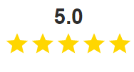
Highly Trusted and Valued by Students
[Back to Phase 1 SWOT]
“Good teachers, Good career preparation, Hands-on training. Extra training offered during 4-year course of study that in many cases would be required later down the road anyway. Great experience and training for field.”
“Good teachers, Positive environment, Good career preparation, Hands-on training. I loved UNC and would go there again.”
“Good teachers, Affordable, Positive environment. Great school. It's the Number 1 pharmacy school in the country. Professors are well-trained and accomplished. There are a diversity of resources available to succeed.”
“There is no better School of Pharmacy than at UNC; it’s ranked #1 in the country for so many reasons! I am a proud Alumnus of the Pharmacy School.”
Source: Indeed, Google Reviews
Notes:
https://www.indeed.com/certifications/companies/unc-eshelman-school-of-pharmacy-in-chapel-hill-nc-TCQJ2AET/reviewshttps://www.google.com/search?q=unc+school+of+pharmacy+school+reviews&oq=unc+school+of+&aqs=chrome.0.69i59l3j69i57j46j69i60l3.2359j0j1&sourceid=chrome&ie=UTF-8#lrd=0x89acc2e5f459ca6b:0x6330cb37810d77ce,1,,,

Slide 78
UNC is national leader in research, ranking 2nd in NIH funding
[Back to Phase 1 SWOT]
37%
Faculty engaged with PharmD Research
50%
Faculty engaged with PhD Advisees
49%
Faculty engaged with Post-Doc Advisees
UNC ranks second in total NIH research funding among institutions receiving awards;
2019 external awards totaling $39,000,650 with $23,679,943 from NIH
UNC Research Specialties
Drug Discovery
Drug Delivery
Drug Optimization
Patient Outcomes
Care Delivery
Research
Funding
$15M
$10.1M
$9.2M
$1.7M
$2.9M
2019 Faculty Area of Focus by Percent Effort
  Average % Effort
  Research
  Admin
  Teaching
  Patient Care
  Service
Source: 2019 Annual Faculty Activity Report, AACP Rankings in External Research Grant Funding

Slide 79
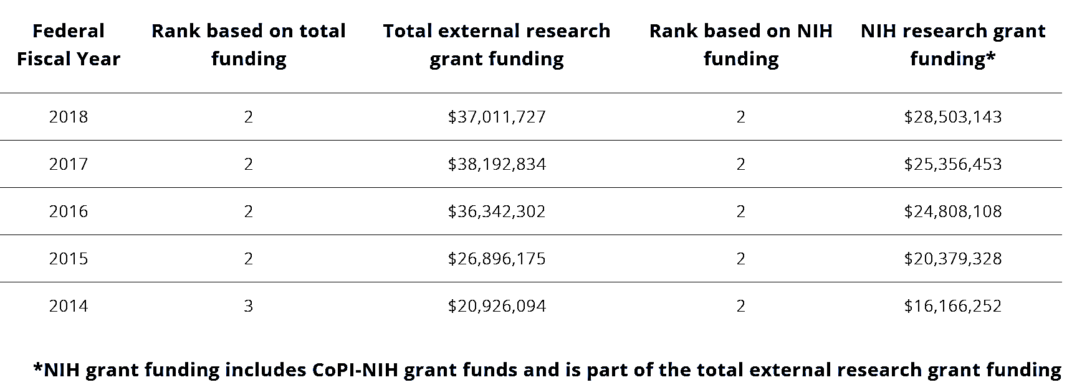
UNC Eshelman School of Pharmacy Ranks #2 in NIH funding
[Back to Phase 1 SWOT]
Notes:
https://pharmacy.unc.edu/about/ospa/factbook-and-benchmarks/rankings/

Slide 80
Culture Amp Employee Engagement Survey reflects similar sentiment regarding UNC Eshelman School of Pharmacy organizational inefficiencies
[Back to Phase 1 SWOT]
On organizational transparency…
On top heavy administration & leadership…
On organizational financial health…
“There's a lack of transparency around how decisions are made and it can be difficult to get answers to questions that directly impact my job or unit.”
Historically there has been very little budget transparency. The message has been everything is equally important but the reality is different. We have a large operation with competing priorities. My concern is that we are going in many directions and often feel like we have significant silos. It is hard to know how things are valued relative to each other within the school. Honest conversation about this would help, in my opinion.
“The School is top heavy. There are a lot of people with some version of "dean" in their title, but it's unclear what a majority of those individuals do on a daily basis.”
“Provide a clear, accessible pathway for inclusive ideas to come to fruition. This should include transparency, engagement in the form of action (as opposed to just listening), and active removal of barriers unique to under-represented and "othered" populations.”
“Top heavy in management roles.”
“Roles for curricular leadership are still unclear. Decisions are also still being made without transparency and two-way communication. Also unclear what some of the offices within the school do, like pharmacoinformatics and curricular innovation.”
[Something ESOP is not doing so great is] “Holding faculty accountable for financial commitments they made when they joined our team.”
“Clarity and transparency on people's roles could be improved…”
Source: School of Pharmacy Employee Engagement Survey via Culture Amp; April 2020

Slide 81
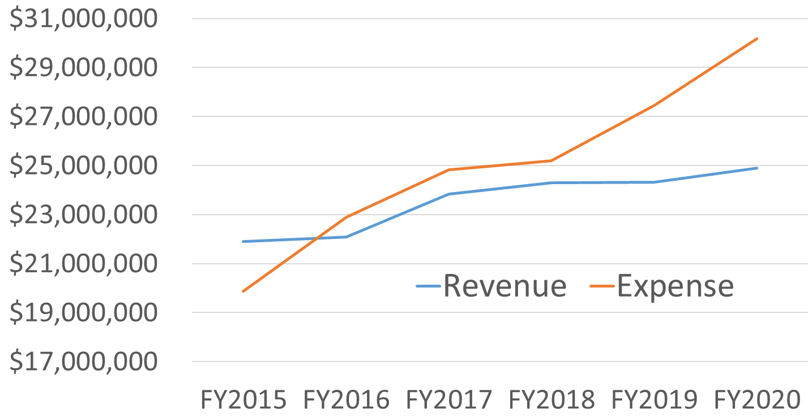
UNC Eshelman School of Pharmacy Financial Picture
[Back to Phase 1 SWOT]
Five-Year Summary
Operational deficit developed over several years due to:
  Aggressive faculty hiring
  Continued support of positions (faculty and staff) after original trust funding was depleted
  Increased curricular and programmatic investments
  Building construction upfit and aging educational technology lifecycle
Dean’s Opportunity Fund ($25M endowment) has bridged the gap
Path for budget neutrality while focusing on sustainability and growth is imperative.
Source: UNC Eshelman Financial Services Team

Slide 82
Top pharmacy schools, including UNC, currently lack diversity
[Back to Phase 1 SWOT]
UNC Eshelman School of Pharmacy
Percent Underrepresented Minority Students, Faculty and Staff
Pharmacy School | Percent underrepresented minorities
All | 17%
UNC | 8.5%
UCSF | 9.9%
Michigan | 7.6%
  % Underrepresented Minorities
Many of the top pharmacy schools, including UNC, have below average minority representation in the PharmD classes
  PharmD
  PhD
  Faculty
  Staff
*Aspirational goal of 33% has been set for all groups
  2020
  Year One Goal
Source: AACP Enrollment Demographic Data, UNC Eshelman Diversity and Inclusion Metrics
Additional appendices: [2020-2021 Organizational DEI Strategic Plan]

Slide 83
2020-2021 Organizational DEI Strategic Plan
[Back to Phase 1 SWOT]
Strategic Priority 1:
Recruit and Retain Diverse Talent
Strategic Priority 2:
Prepare Culturally Intelligent Professionals
Strategic Priority 3:
Build an Inclusive Community
Goal: To increase underrepresented communities to be 33% of overall population (PharmD students, PhD students, faculty, staff)
Goal: To obtain high student ratings (i.e. 3.5/4.0) and test scores > 90% on culture assessments
Goal: 75% favorable responses regarding community (70% within minority community) and test scores > 90% after training
Methodology:
  PCAT/GRE Score Optional
  Adapt Multiple Mini Interviews (MMI)
  Host symposium and schedule visiting tours for HBCUs and MSIs
  Collaborate to develop evidence-based strategies
Methodology:
  Real world cases in all courses taken by students
  Social equity and cultural intelligence education
  Annual faculty development training with CIPhER
Methodology:
  Racial Equity Institute training
  Social equity and cross-cultural education
  Host annual seminar each semester for school community
Notes:
Nisarg

Slide 84
Many student career plans do not align with market opportunity
[Back to Phase 1 SWOT]
Student Primary Employment Upon Graduation 2019-2020
Job Market Trends by Position
  2019
Position | Total Job Postings in 2019 | Quarterly Growth Trend
All Positions (excluding pharmacy tech) | 14,451 | Steady
Clinical Pharmacists | 4,522 | Increasing
Hospital Pharmacists | 1,491 | Decreasing
Pharmacy Director | 890 | Decreasing
Pharmacy Tech | 133,702 | Increasing
Retail Pharmacists | 4,605 | Steady
Other* | 2,943 | Steady
  2020
  Community
  Residency
  Fellowship
  Industry
  Other
*Includes Compounding Pharmacist, Informatics Pharmacist, Long-term Care Pharmacist, Nuclear Pharmacist, Oncology Pharmacist
Sources: UNC Graduation Reporting, Final Report of the National Pharmacist Workforce Study 2019 (PDF)
Notes:
Sam

Slide 85




Key Takeaways from Competitor Profiles
[Back to Phase 1 SWOT]
Digital Learning
Competitors are creating unprecedented opportunities to connect with learners around the world, investing in digital courses, software applications, and digital learning platforms
Interdisciplinary Research
Global competitors (Schools of Pharmacy, Medicine, Engineering) are all emphasizing the importance of stimulating interdisciplinary research and collaboration across Faculty, creating new possibilities for research, education, and solutions for better health in our communities
International Partnerships
A key initiative for many top global competitors is strengthening and forging international partnerships. Competitors have large numbers of partnerships with international companies and external university partners
Community Involvement
Many top schools are focusing on collaboration with their local (and global) communities to advance health. Competitors emphasize partnerships with community and government leaders, clinics, organizations, expanding community programs, and getting alumni involved
Source: Competitor Schools Individual Websites
Additional appendices: [Competitor Profiles] [Hanover Market Analysis]

Slide 86
[Back to Phase 1 SWOT]
The following slides provide key insights on what global competitors in pharmacy, medicine, and engineering are implementing
Insights regarding:
Research
Degree Offerings
Productivity
Strategic Initiatives
Competitor
Profiles

Slide 87









Top School of Pharmacy Comparison Chart
[Back to Phase 1 SWOT]
Monash and Toronto University: Perfect Score in Academic Reputation | Harvard University: Perfect Score in Employer Reputation | Nottingham: Perfect Score in Citations Per Paper
Ranking | 1 | 2 | 3 | 4 | 5 | 6 | 7 | 8 | 9
Citations Per Paper Score | 98.4 | 91 | 91.7 | 91.8 | 93.9 | 91.9 | 100 | 90.9 | 90.8
Academic Reputation Score | 88.6 | 100 | 92.3 | 100 | 86.7 | 89.8 | 87.8 | 93.6 | 92.7
Employer Reputation Score | 95.8 | 81.2 | 100 | 85.6 | 82 | 95.7 | 65.1 | 75.1 | 65.6
Source: QS World University Rankings by Subject – QS analyzed 162 million research citations deriving from 22.5 million research papers

Slide 88

Top Medicine School Comparison Chart
[Back to Phase 1 SWOT]
Harvard University: Perfect Score in Academic Reputation and Employer Reputation for their School of Medicine
Ranking | 1 | 2 | 3 | 4
Citations Per Paper Score | 96.5 | 97.9 | 95.9 | 96.4
Academic Reputation Score | 100 | 96.6 | 96.5 | 93.7
Employer Reputation Score | 100 | 94.8 | 95.5 | 92.2
Source: QS World University Rankings by Subject

Slide 89


Top Engineering School Comparison Chart
[Back to Phase 1 SWOT]
MIT: Perfect Score in Academic Reputation | Stanford: (Nearly) Perfect Score in Citations Per Paper
Ranking | 1 | 2 | 3 | 4
Citations Per Paper Score | 95.1 | 99.9 | 91.9 | 93.8
Academic Reputation Score | 100 | 97 | 95 | 99.8
Employer Reputation Score | 98.1 | 94.7 | 98 | 86.6
Source: QS World University Rankings by Subject

Slide 90
A Closer Look: Top Global Competitors Degree Offerings and Research
[Back to Phase 1 SWOT]
Offerings
Undergraduate degrees
Bachelor of pharmacy
Masters of pharmacy
Bachelor of pharmaceutical science
Postgraduate Offerings
Clinical pharmacy
Master of pharmacy
Graduate entry pharmacy
Wound care
Monash Internship Programs
Research degrees/Doctoral program
Honours degree in Pharmaceutical Science (1 year program)
Master of Philosophy
Doctoral Program
Offerings
Doctor of Pharmacy
Doctor of Philosophy in Pharmaceutical Sciences
Master of Science in Pharmaceutical Sciences
Master of Science in Pharmacy
PharmD for Pharmacists
PharmD – MBA
Pharmaceutical Chemistry Specialist
Residency Programs
International Pharmacy Graduate Program
Continuous Professional Development
Research Focuses
Molecular Basis of Drug Targets and Diseases
Drug Development and Disease Diagnostics
Clinical Pharmacy Research
Drug Safety
Health Services Research
Research Focuses
Drug Candidate Optimization
Drug Delivery, Disposition and Dynamics
Drug Discovery Biology
Medicinal Chemistry
Centre for Medicine Use and Safety
International collaboration with other top schools
Offerings
Master of Pharmacy (MPharm)
MSc in Clinical Pharmacy, International Practice
MSc in Drug Discovery and Development
MSc in Drug Discovery and Pharma Management
MSc in Experimental Pharmacology and Therapeutics
MSc in Pharmaceutical formulation and entrepreneurship
MSc in Pharmaceutics
Master of Research Drug Sciences
MPhil/PhD
Professional Development
Research Focuses
Age related medicines development and use
Drug discovery and therapeutic target identification
Fabrication and synthetic technologies for advanced drug delivery
Medicines use and optimization
Pharmacoepidemiology and medication safety
Translational neuroscience
*Bold indicates degree offering or equivalent is not offered at Eshelman
Source: Competitor Websites

Slide 91
Overview of Strategic Initiatives of Top Global Competitors
[Back to Phase 1 SWOT]
Strategic Initiatives: What is each top global competitor focusing on?
Harvard University
Stanford University
Monash University
University of Toronto
Exploring Opportunities to Bring Interprofessional Teams Together
Expanding Online Offerings
Collaborating with International Schools and Treating Patients Across the World
Focusing on Collaborative, Interdisciplinary Research
Improving Team-Based Patient Care in the United States and Abroad
Collaborations and Partnerships with other Schools of Medicine
Being Digitally Driven and Looking for Innovation Globally
International Reach, Partnerships, Offshore Campuses
Engagement with government, alumni, and industry
Innovative Education Offerings, Digital Offerings
Bringing Together Disciplines to Tackle Research Challenges
Advance Education Programs
Lead Innovations in Pharmacy Education
Grow Scientific Impact
Build a Distinct Identity
Improve Influence on Policy Work in Canada
Source: Strategic Plans of Competitors and Competitor Websites

Slide 92
A Closer Look: University of Toronto
[Back to Phase 1 SWOT]
1
2
3
Lead Innovations in Pharmacy Education
Grow Scientific Impact
Improve Influence on Policy in Canada
  Explore and integrate new technologies to enhance course delivery
  Increase the capacity of the Office of Experiential Education to support all programs
  Enhance ability to track and support individual learner progress within each program
  Enhance collaborative learning in the curriculum
  Support strong, integrated teams that will be competitive for collaborative grant applications
  Engage with partners to identify, shape, and respond to the most important research issues and enhance impact
  Measure and communicate the impact of research
  Work collaboratively across Faculty to organize symposia on topics of national and global interest
  Create a stronger public and private sector presence for research and a forum for showcasing work
  Optimize opportunities to engage in multi-stakeholder collaborations that impact the health of Canadians
  Create collaborations with governments to enhance impact
Key Initiatives:
University of Toronto

Slide 93
A Closer Look: Monash University
[Back to Phase 1 SWOT]
1
2
3
Build Strength of International Research
Build International Partnerships
Providing Innovative Education Offerings
  Develop and recruit high-performing researchers and graduate research students from across the globe
  Invest in areas where Monash can have an impact and research expertise of high international standing
  Invest and maintain world-class research infrastructure
  Foster research that leverages their expertise, bringing together disciplines
  Enrich ability to innovate, infuse students and staff with enterprising capabilities, and provide opportunities to apply research and make a significant impact on communities
  Monash University strives to build international partnerships and offshore campuses into a global research network
  Identify areas of collaboration across networks
  Encourage greater student mobility
  COMET: curriculum management and e-portfolio software
  Pharmatopia: Interactive web-based modules
  MyDispense: A dispensing system with many features of commercial dispensing programs to give students authentic experience in modern practice.
  Pharmville: A teaching tool that depicts people with real problems to provide context and integration throughout the undergraduate program.
  Monash University invests in innovative software applications for online learning and career exploration
Key Initiatives:
Monash University

Slide 94
Hanover Market Analysis Key Findings and Competitive Positioning
[Back to Phase 1 SWOT]
1. Bachelors in Pharmaceutical Sciences
  Prepare students to pursue research assistant positions that help them advance to graduate education or transition into private sector research
  Trends in pharmaceutical science-related programing indicate there may be a push towards non-doctoral degree paths
2. Master's in Health-System Pharmacy Administration
  Strong employment projections indicate growing labor market demand for graduates of pharmacy leadership/administrative related programs
  Growing master's conferrals nationally demonstrated increasing student interest in leadership/administrative-related programs
3. Master's in Regulatory Science
  Size of prospective student market directly from undergraduate pharmacy programs is small but growing, with online regulatory degree programs growing
  Over 50% of competitor programs are in an online format
Competitive conditions may cause an oversupply of existing programs
Competitive conditions support a new degree program
30%
1
(23.1%, 25.7%)
15%
3
(5.6%, 10.7%)
Program Offered Growth Rate
2
(6.7%, 4.9%)
0%
-15%
Competitive conditions are unsuitable to support a new program
Student demand exists, but may be satisfied by existing programs
-30%
-15%
0%
15%
30%
Degree Completions Growth Rate

Slide 95
Hanover Market Analysis Competitors and Top Employers
[Back to Phase 1 SWOT]
Bachelor's in Pharmaceutical Sciences
Master's in Health-System Pharmacy Administration
Master's in Regulatory Science
253 Southeast and 1,011 National degree completions in 2018
1,727 Southeast and 11,220 National degree completions in 2017
373 Southeast and 1,792 National degree completions in 2017
University of Mississippi
Samford University
Campbell University
University of Georgia
Belmont University
University of Cincinnati
Dequesne University
Long Island University
Northeast Ohio University
St. John's University
University of Houston
Arizona State University
George Washington University
Johns Hopkins University
Northeastern University
University of Southern California
Temple University
Program Competitors
1,639 Related jobs in research assistance roles
25,867 Related jobs in Medical and Health Services Manager roles in NC
2,159 Related jobs in Regulatory Affairs Manager roles in NC
Top Employers
Medical University of South Carolina
Emory University
Louisiana State University
University of North Carolina, Chapel Hill
University of Alabama in Huntsville
University of Miami
CVS Health
UnitedHealth Group
HCA
Walgreens
Kaiser Permanente
Clinical Management Consultants
Sava Senior Care
Navant Health
Carolinas Healthcare
Duke University and Health System
Quintiles
IQVIA

Slide 96
Eshelman Institute for Innovation provides opportunities to focus on entrepreneurship
[Back to Phase 1 SWOT]
EII Innovation
Product Output | Total # in 2019 | Percent from EII
Patents | 10 | 20%
Patent Application | 21 | 43%
Invention Disclosure | 38 | 24%
License Agreement | 11 | 27%
IRB Clinical Trials Initiated | 40 | -
New Companies | 2 | 0%
Copy Rights | 2 | 50%
We define innovation as the creation and implementation of a transformative idea that makes an impactful difference on the world.
The institute provides:
Funding - Providing funds for innovative opportunities
Resources - Supporting commercialization of new products, services and technology
Training - Developing and inspiring a community of innovators
Source: 2019 Annual Faculty Activity Report
Additional appendices: [Eshelman Institute for Innovation Impact Report]
Notes:
10,
5,5,5,5,

Slide 97
Eshelman Institute for Innovation Impact Report
[Back to Phase 1 SWOT]
Purpose
To create and sustain an Innovation Engine to enable the UNC Eshelman School of Pharmacy to define and pursue bold, new, innovative ways to move the mission of the School forward and extend its position as a global leader.
Strategy
To help innovators take the Next Step forward in advancing medicine for life.
Process
Ideate -> Fund -> Deliver -> Commercialize
Results
$26.1M EII Grants Awarded -> 19 Patent Applications / 55 Invention Disclosures / $17.4M Startup Funds Raised -> 240+ Students Trained
Capability
Building on our strengths through strategic investments and collaborations at UNC and beyond, we aim to expand our ability to commercialize our discoveries and improve patient lives.
Notes:
Nisarg

Slide 98







Impact Report – Achievement Areas
[Back to Phase 1 SWOT]
Research Enterprise – #2 in total research funding among US pharmacy schools
Practice Advancement – Community residency programs, hospital partnerships in patient care, research focus with Center for Medication Optimization (CMO)
Accelerating Innovation – Eshelman Institute for Innovation funded 107 projects through $21.9M in awarded grants
From Local to Global – From Rural Health Scholars program to Global Scholars rotations in 9 countries
Culture of Collaboration – Pinnacle Hill, LLC launched through a UNC and Deerfield Management partnership to discover new medication for unmet needs
Our People – DEI initiatives focused on recruitment and culture, launch of a Resilience and Well-Being task force
Investing in the Future – $175 million campaign goal toward students, faculty, innovation, global and building

Slide 99
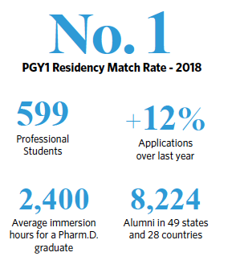
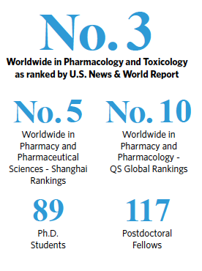
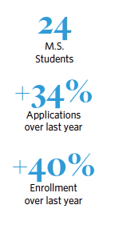
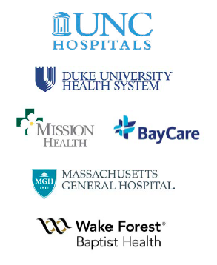
Impact Report – Educational Programs
[Back to Phase 1 SWOT]
Pharm.D. Program
Ph.D. Program
M.S. Program
In May 2019, the School graduated the inaugural class of students in our new, transformative Pharm.D. curriculum
Developing tomorrow’s scientists in basic, translational, or health outcomes research with concentrations in drug discovery, drug optimization and patient outcomes
Preparing pharmacists for leadership positions by
classroom instruction and two-year residency in a health system setting
Program collaboration with:

Slide 100
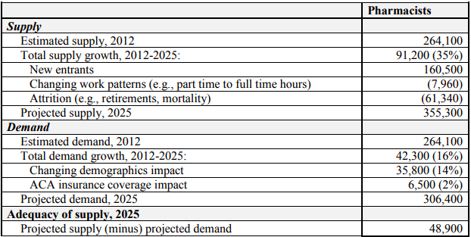
HRSA projects there to be an oversupply of pharmacists in 2025
[Back to Phase 1 SWOT]
Demand for pharmacists is not growing as quickly as supply, leading to an over supply of trained professionals
Modeled using characteristics of the existing workforce, new entrants to the workforce and workforce decisions
Modeled using population demographics, health care use, and demand for prescription medications
Source: National Center for Health Workforce Analysis
Additional appendices: [2019 Pharmacy Demand Report], [Alternative career paths]
Notes:
https://bhw.hrsa.gov/sites/default/files/bhw/nchwa/projections/pharmacists.pdf

Slide 101
2019 Pharmacy Demand Report Demonstrates Areas of Growth
[Back to Phase 1 SWOT]
Pharmacy Workforce Center analyzed 2019 pharmacy demand by using Burning Glass Technologies' Labor Insight Labor Market Information which measures total number of job postings by pharmacy role type
Position | Total Job Postings in 2019 | Quarterly Growth Trend | States with highest demand | States with lowest demand
All Positions (excluding pharmacy tech) | 14,451 | Steady | CA, FL, TX, OH | PR, SD, VT, DE
Clinical Pharmacists | 4,522 | Increasing | CA, FL, TX, IL | WY, ND, PR, HI
Hospital Pharmacists | 1,491 | Decreasing | CA, TX, OH, WI | DE, DC, NH, PR, RI
Pharmacy Director | 890 | Decreasing | CA, TX, MI, WA | DE, ME, MO, SD
Pharmacy Tech | 133,702 | Increasing | VI, GU, WY, PR | CA, TX, FL, MI
Retail Pharmacists | 4,605 | Steady | CA, PA, TX, FL | HI, PR, DE, SD, VT
Other* | 2,943 | Steady | CA, IL, FL, MI | ND, RI, VT, WV
*Includes Compounding Pharmacist, Informatics Pharmacist, Long-term Care Pharmacist, Nuclear Pharmacist, Oncology Pharmacist
Sources: Final Report of the National Pharmacist Workforce Study 2019 (PDF)

Slide 102
[Back to Phase 1 SWOT]
Alternative career paths go beyond traditional recruiting paths
Comopounding Pharmacist - Specializes in preparation ofalternate modes of delivery and forms of commercial medication not available in retail or hospitalpharmacies
Informatics Pharmacist - Improves precision and safety of prescribing and administering medications byusing technology and data analysis. Draws on both pharmaceutical expertise and computer science toimprove patient outcomes.
Infusion Pharmacist - Specializes in drugs delivered through infusion, using a needle or a catheter. Works primarily in healthcare facilities.
Long-term Care Pharmacist - Works in a long-term care facility or pharmacy. May be directly involvedin patient care, working with physicians and healthcare workers to manage the long-term health of thepatients in the facility.
Nuclear Pharmacist - Works for a pharmacy or a healthcare facility dispensing nuclear medicines(made from radioactive materials).
Oncology Pharmacist - Specializes in managing complex pharmacotherapeutic plans for treatment and preventionof cancer and cancer-related diseases.
Pharmacutical Fellowships - focused on medical affairs, regulatory affairs, clinical development
Entreprenurial Ventures (pharma/biotech, care innovation, technology)
Sources: Final Report of the National Pharmacist Workforce Study 2019 (PDF), Pharmacy Fellowships
Notes:
Sources: https://www.pharmacyfellowships.com/residency-vs-fellowship.html

Slide 103
COVID-19 has impacted the economy and job market
[Back to Phase 1 SWOT]
-32.9%
Gross Domestic Product (GDP) Q2 2020
8.4%
Unemployment rate due to impacts from COVID-19
-16%
Job postings since February 2020
Although the trajectory of the US economy remains uncertain, the impact of COVID-19 has already had a huge effects on the US
Source: Bureau of Labor Statistics, McKinsey
Additional appendices: [COVID Implications on Pharmacy, Is the Future of Pharmacy that Bright?]
Notes:
https://www.bls.gov/news.release/pdf/empsit.pdf
https://www.mckinsey.com/industries/public-and-social-sector/our-insights/covid-19-and-jobs-monitoring-the-us-impact-on-people-and-places#:~:text=Data%20from%20Emsi%2C%20which%20consolidates,a%20drop%20of%2016%20percent.&text=These%20declines%20do%20not%20necessarily,are%20needed%20in%20these%20occupations.

Slide 104

What happens after COVID 19?
[Back to Phase 1 SWOT]
Implications on Pharmacy Post-COVID 19
The time has come for retail pharmacy to pivot – delivery of medications is critical now. If delivery becomes a high-quality service, it will take a lot of marketing to bring consumers back to the pharmacy.
Pharmacy startups that have focused on new delivery methods for medications (on demand) are capitalizing on consumer behaviors. No one wants to shop in public right now.
Pharmacies will need to leverage online resources and compete on a digital landscape. The rest of healthcare is moving toward technology.
Retail Pharmacy
Needs to Pivot
Pharmacy Startups Will Capitalize on Trends
Compete on a Digital Landscape
Sources: The Digital Apothecary: COVID Implications on Pharmacy, Is the Future of Pharmacy that Bright?

Slide 105
Applications are decreasing year over year for PharmD programs
[Back to Phase 1 SWOT]
PharmCAS applications include submissions to participating PharmD programs
  Total PharmCAS Applications from 2012-2019
  Total PharmCAS UNC Applications from 2012-2019
CAGR
CAGR
  -9%
  -5%
  2012
  2013
  2014
  2015
  2016
  2017
  2018
  2019
Application Trend: - 49%
Number of Participating Schools: 29%
Application Trend: - 28%
Source: AACP Application Data, UNC Eshelman Application Data
Additional appendices: [What Students Want: Round Table Discussion] [PharmD Enrollment Trends]

Slide 106

What Students Want: Round Table Discussion
[Back to Phase 1 SWOT]
Students from top pharmacy programs sat at a round table and discussed the future of pharmacy education and the industry
Student Pharmacists
Discuss the Future of Pharmacy
Student described their ideal jobs: some said community pharmacy and hospital, other expressed interests in ambulatory care, pharmacogenomics, and other innovative pharmacy careers
Students agreed that residencies would play a crucial role in their ability to be successful in the future
Students have concerns about lack of proper reimbursement for pharmacy services, pharmacy spread concerns, and direct and indirect remuneration fees
They also discussed the importance of technology and technical knowledge for the future of the pharmacy profession
Students love dual-degree programs. They are concerned about competition when searching for innovative jobs
Source:Student Pharmacist Leaders Discuss the Future of Pharmacy – Brittany Hoffmann-Eubanks

Slide 107
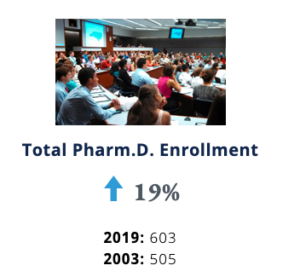
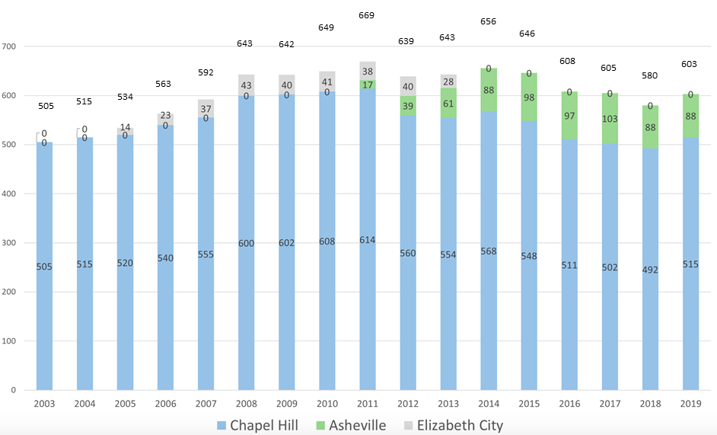
PharmD Enrollment Trends
[Back to Phase 1 SWOT]
  PharmD Enrollment by Campus 2003-2019
Enrollment difference from 2012-2019: - 11%

