Slide 2
Agenda
Where We Are
Where We Want To Go
How We Get There
2

Slide 3
Agenda
Where We Are
Where We Want To Go
How We Get There
3

Slide 4
Planning and Engagement
Phase 1
Assessment
Phase 2
Visioning
Phase 3
Strategy
6 Months
25 Planning Meetings;
475 People Hours
10 Town Halls,
300+ different participants
13 Surveys;
1,955 Responses
September
October-November
December-January
Environmental
Scan
Internal & external surveys
Benchmarks
Interviews
SWOT
Strategy
Statements
Mission
Vision
Values
Strategic
Plans
Objectives
Strategic Priorities
Draft Key Metrics
Average Survey Scores (5 pt scale)
Faculty 4.23
Staff 4.42
Students 4.41
4

Slide 5
Planning and Engagement
“The ESOP Strategic Planning process was the most inclusive of any I have worked on. The task force insisted on more open forums, advisory meetings, surveys, department meetings, one-on-ones, etc. and I saw why. The faculty, staff and students participated in great numbers and offered terrific ideas. It is a special community with strategic leadership.”
Paul N. Friga, Ph.D. Clinical Associate Professor of
Strategy and Entrepreneurship
UNC Chapel Hill Kenan-Flagler Business School
5

Slide 6
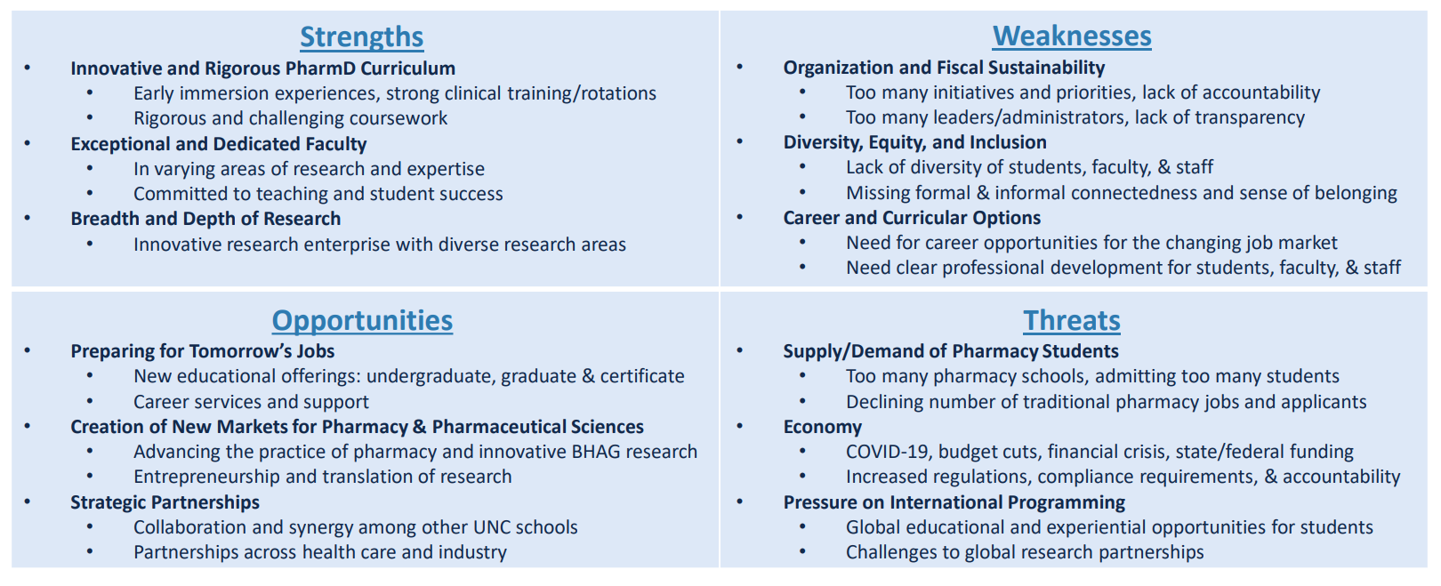
Our Learnings
Internal
External
Leverage
Mitigate
6

Slide 7
Organizational and Fiscal Sustainability
$4,390,573
Deficit
7

Slide 8
Agenda
Where We Are
Where We Want To Go
How We Get There
8

Slide 9
BEYOND Rankings
BEYOND Borders
BEYOND Classrooms and Labs
BEYOND Excellence
9

Slide 10
Agenda
Where We Are
Where We Want To Go
How We Get There
10

Slide 11
Guided By Vision, Mission, Values and Priorities
Vision
To be the global leader
in pharmacy and pharmaceutical sciences
Mission
Preparing leaders and innovators
to solve the world's health care challenges
Values
WE CARE:
Welcoming, Equity, Commitment, Accountability, Respect, Excellence
Strategic Priorities
Create the most engaging culture
Accelerate innovation and transformational change in pharmacy and the pharmaceutical sciences
Improve the operating efficiency to invest in strategic areas
11

Slide 12
Strategic Priorities
Create the most engaging culture
Foster Diversity, Equity, & Inclusion
Improve Well-being & Resiliency
Expand Engagement
Carla White
Suzie Harris
Angela Lyght
Accelerate innovation and transformational change in pharmacy and the pharmaceutical sciences
Prioritize Research & Translation
Develop Educational Offerings
Advance Practice
K. Brouwer/J. Bamforth
Mary McClurg
Stefani Ferreri
Improve operating efficiency to invest in strategic areas
Optimize Cost/Expense Levers
Drive New Revenue Generation
Enhance Facilities and Physical Space
Matt Rivenbark
Angela Kashuba
Scott Savage
12

Slide 13
Initiatives We Plan to Continue
Research and Translation
Education
Practice
Organizational Initiatives
Pursuit of internationally ranked, vanguard, high impact collaborative research
Recruitment and retention of high impact faculty
Our focus on entrepreneurship and translation
Support sustainability of the EII, including new DDI and READDI initiatives
Support of our Centers’ fiscal sustainability and high impact
Leading in educational innovation through research and educator development, nationally and internationally
Our approach to Continual Quality Improvement of our strong curricula
Outreach to NC practice sites/partnership development
Connecting and enhancing our relationship with key stakeholders
Strengthening our relationships with health system pharmacy partners
Expanding funded practice-based research efforts
Developing impactful advocacy initiatives
Our focus on data driven decision making
Enhancing faculty, staff, student, and alumni engagement
Faculty mentoring programs
Pan-ESOP initiatives: The Partnership in Patient Care, PharmAlliance, UNC Health Sciences at MAHEC
13

Slide 14
Priority #1: Create the most engaging culture
Objectives​ | Initiatives​ | Proposed Team Members​
Foster Diversity, Equity, & Inclusion​ (Carla White)​ | Recruit and retain diverse talent​ | Ami Patel, John Bamforth, Annie Hager-Blunk, Pamela Davis-Reeves, Klarissa Jackson, Jennifer Lafata, Sara Pettaway, Nicole Kenny, Justin Veeder (postdoctoral fellow), Kevin Wiltz (alumnus), Christian Brown (PY2), Ava Vargason (graduate student), Marshall Winget (PY2) ​
 | Prepare culturally intelligent professionals​
 | Build an inclusive community​
Improve Well-being & Resiliency​ (Suzie Harris) ​ | Create a comprehensive employee and student wellbeing program ​ | Brad Wingo, Mike Jarstfer, Heidi Anksorus, Mike Mulkeen, Kyle Ritter (PY2), Frank Tillman (UNCH)​
 | Establish cross-campus collaborations to implement best practices that promote well-being and resiliency across health sciences​
Expand Engagement​ (Angela Lyght)​ | Provide access to mentorship and educational opportunities for career advancement and continuous professional development​ | Scott Savage, Mary McClurg, Director of Postdoctoral Programs, Austin Companion, Laura Bratsch, Adam Persky, Ashlie Thomas​
 | Improve culture through school and unit-specific initiatives​
14

Slide 15
Priority #2: Accelerate innovation and transformational change in pharmacy & pharmaceutical sciences
Objectives​ | Initiatives​ | Proposed Team Members​
Prioritize Research & Translation​ (Kim Brouwer/ John Bamforth)​ | Create a strategy and secure significant personnel resources to become a recognized leader in neuroscience drug discovery/development & therapeutic applications​ | Near Term: Sumitra Pati, Ruth Everett, Nathan Blouin​ Long Term: add Stephen Frye, Erin Heinzen, Jeff Aube, Bryan Roth​
 | Use translation and entrepreneurship to deliver tangible new products and services all the way to the market; enhance IP commercialization for greater success​ | Roy Zwahlen, Kelly Collins, Stefanie Ferreri
Develop Educational Offerings​ (Mary McClurg)​ | Launch new high value, sustainable degree programs​ | Education Advisory Committee (EAC) - Mary McClurg, Amanda Corbett, Wendy Cox, Stephen Eckel, Chris Gosk, Josh Guffey, Mike Jarstfer, Catherine MacAllister, Jacqui McLaughlin, Denise Rhoney, Carla White, Heidi Collins​
 | Launch micro credential, professional education, and resources for emerging and untapped careers ​ | EAC, and additional staff and faculty​
 | Establish programs to attract and retain students in rural and underserved areas in NC​ | EAC, Wendy Cox, Mike Jarstfer​
Advance Practice​ (Stefanie Ferreri)​ | Transform the business model to develop sustainable pharmacy services in NC​ | Proposed: Mary McClurg, Greene Shepherd, Mollie Scott, Jon Easter, and Stephanie Kiser, Betsy Sleath, Nicki Reitter, Macary Marciniak, Benyam Muluneh, Lesha Carpenter, UNC Health (Udobi Campbell, Tim Weber), Western and Eastern (Skip Cummings) NC representatives, Payor perspective (Medicaid, BCBS)​
 | Advance the delivery and quality of patient care in community pharmacy and ambulatory care across NC​
15

Slide 16
Priority #3: Improve operating efficiency to invest in strategic areas
Objectives​ | Initiatives​ | Proposed Team Members​
Optimize Cost/Expense Levers​ (Matt Rivenbark)​ | Create resource allocation for all expenses​ | Core: Scott Savage, and Roy Zwahlen.​ Others: Budget Committee (BC) and FAO Directors - Albert Bowers, Shawn Hingtgen, Mary McClurg, Shawn dos Santos, Mollie Scott, Betsy Sleath, Bill Zamboni, Kim Brouwer, Nicole Kenney, Jason Martin, Stan Parker, Jason Whitley, Dave Maldonado​
 | Create transparent process for discontinuing initiatives and removing redundant activities​
 | Refinance and pay off facility/building debt ​
Drive New Revenue Generation​ (Angela Kashuba)​ ​ | Improve “go to market” strategy for new initiatives and partnerships​ | Scott Savage, Roy Zwahlen, Stan Parker, Bob Dieterle​
 | Align strategic priorities with fundraising priorities to drive more philanthropic investment ​ | Scott Savage, Mary McClurg, Mollie Scott, Stephen Eckel, Betsy Sleath, Wendy Cox, Carla White, Annie Hager-Blunk, Kim Brouwer, Roy Zwahlen, John Bamforth, Kelly Collins, Tab Waldrop​
 | Sustainably operationalize and grow the Eshelman Institute of Innovation​ | John Bamforth, Kelly Collins, Roy Zwahlen, Scott Savage​
Enhance Facilities and Physical Space​ (Scott Savage)​ | Improve shared space for students, faculty, staff, and collaborators to interact and engage​ | Stan Parker, Brad Wingo ​
 | Develop facility plan that aligns with priorities, campus partners and multi-campus presence​ | Evan Yassky​
 | Allocate sufficient funds for space maintenance and technology upgrades​ | Jason Martin, Chris Allen, Budget Committee​
16

Slide 17
Moving to Implementation
Phase 1
Assessment
Phase 2
Visioning
Phase 3
Strategy
Phase 4
Implementation
September
October-November
December-January
February-May
Environmental
Scan
Internal & external surveys
Benchmarks
Interviews
SWOT
Strategy
Statements
Mission
Vision
Values
Strategic Plan:
Objectives
Strategic Priorities
Draft Key Metrics
Implementation Plan:
Teams
Key Metrics
Unit Plans
Office of OE
Cascade
Execution, Tracking, &
Quarterly Reviews
Ongoing
17

Slide 18
Strategic Plan Digital Brochure
Strategic Plan PPT
Background and Development
Dash
Board
Foster Diversity, Equity and Inclusion
Improve Well-being and Resilience
Expand Engagement
Learn more
Project Management Software
Easy access via FAO site
Transparency
Real time reporting on progress & metrics
Prioritize Research and Translation
Develop Educational Offerings
Advance Practice
Learn more
Optimize Cost/Expense Levers
Drive New Revenue Generation
Enhance Facilities and Physical Space
Learn more
18

Slide 19
Going BEYOND Together
We are moving into a new phase for the UNC Eshelman School of Pharmacy.
We have developed a strong plan together.
We will address our sustainability issues together.
Only together can we can go BEYOND excellence.
19

